Slide 1


Power and limitations of distributed state purification
Benchi Zhao, Yu-Ao Chen, Xuanqiang Zhao, Chengkai Zhu,
Giulio Chiribella and Xin Wang
PRL 136,090203
Date: 2026.03.16

Slide 2
Background & Motivation
Quantum computing provide exponential speed up in certain problems
Two main obstacles: Scalability + Noise

Slide 3

Background & Motivation
Quantum computing provide exponential speed up in certain problems
Two main obstacles: Scalability + Noise
Current Quantum Device
？
Requirement
~1000 qubits
${10}^{6}\sim {10}^{8}$ qubits
Notes:
Current best quantum chips can manipulate around 1000 qubits, while solving practical tasks such as Shor’s algorithm need around 10^6 qubits.
There is a big gap.
To solve scalability, one natural way is to develop quantum hardware to make quantum chips bigger.

Slide 4


Background & Motivation
Quantum computing provide exponential speed up in certain problems
Two main obstacles: Scalability + Noise
Current Quantum Device
Requirement
~1000 qubits
Distributed
Quantum
Computing
${10}^{6}\sim {10}^{8}$ qubits
$$⋯$$
Notes:
Another way is utilizing a paradigm called the distributed quantum computing, which combine multiple quantum chips and use them together.
The good thing is that we can easily increase the number of qubit. But the operation is limited to LOCC only.

Slide 5
Background & Motivation
Quantum computing provide exponential speed up in certain problems
Two main obstacles: Scalability + Noise
Current Quantum Device
Requirement
~1000 qubits
Distributed
Quantum
Computing
${10}^{6}\sim {10}^{8}$ qubits
$$⋯$$
WHAT ABOUT NOISE?
Notes:
Then what about noise, the quantum noise could corrupt the quantum systems, making the results unreliable.
There are many way to solve noise such as quantum error correction code and error mitigation.
Here I would like to talk about another strategy called purification. The main idea is to generate a less noised quantum state by consuming multiple noisy copies.

Slide 6
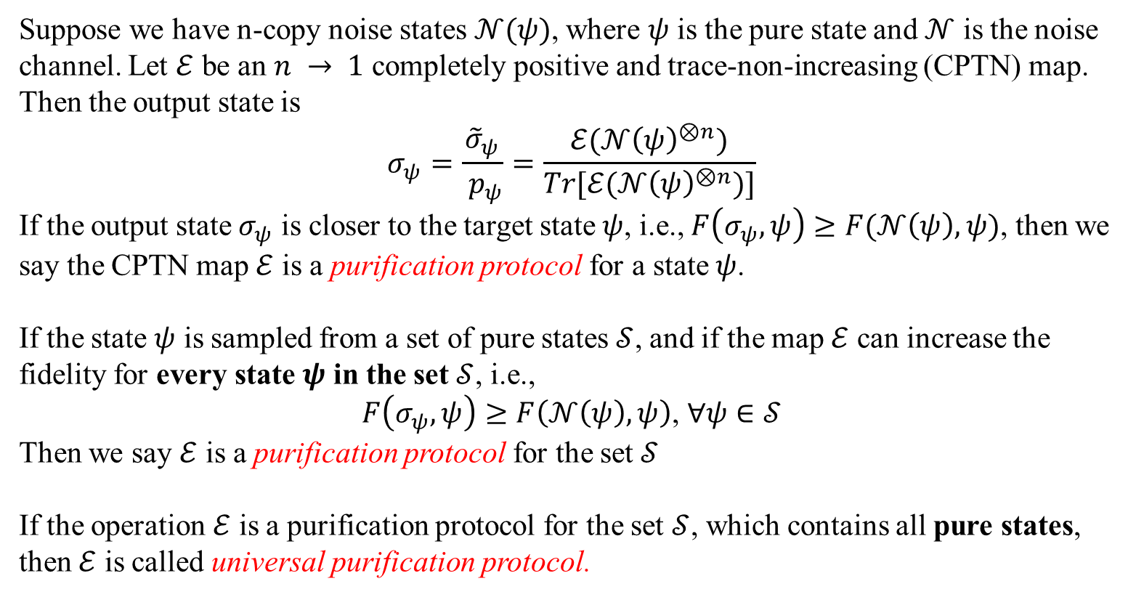
Definitions
Quantum state purification is a promising method to reduce quantum noise
Suppose we have n-copy noise states $𝒩(ψ)$, where $ψ$ is the pure state and $𝒩$ is the noise channel. Let $ℰ$ be an $n → 1$ completely positive and trace-non-increasing (CPTN) map. Then the output state is
$$σ_{ψ}=\frac{{\tilde{σ}}_{ψ}}{ p_{ψ}}=\frac{ℰ(𝒩{\left(ψ\right)}^{⊗n})}{Tr[ℰ(𝒩{\left(ψ\right)}^{⊗n})]}$$
If the output state $σ_{ψ}$ is closer to the target state $ψ$, i.e., $F\left(σ_{ψ},ψ\right)≥F(𝒩\left(ψ\right), ψ)$, then we say the CPTN map $ℰ$ is a purification protocol for a state $ψ$.
If the state $ψ$ is sampled from a set of pure states $𝒮$, and if the map $ℰ$ can increase the fidelity for every state $ψ$ in the set $𝒮$, i.e.,
$$F\left(σ_{ψ},ψ\right)≥F\left(𝒩\left(ψ\right), ψ\right)\text{, }∀ψ∈𝒮$$
Then we say $ℰ$ is a purification protocol for the set $𝒮$
If the operation $ℰ$ is a purification protocol for the set $𝒮$, which contains all pure states, then $ℰ$ is called universal purification protocol.
Notes:
Ok here is the brief introduction to quantum state purification.

Slide 7
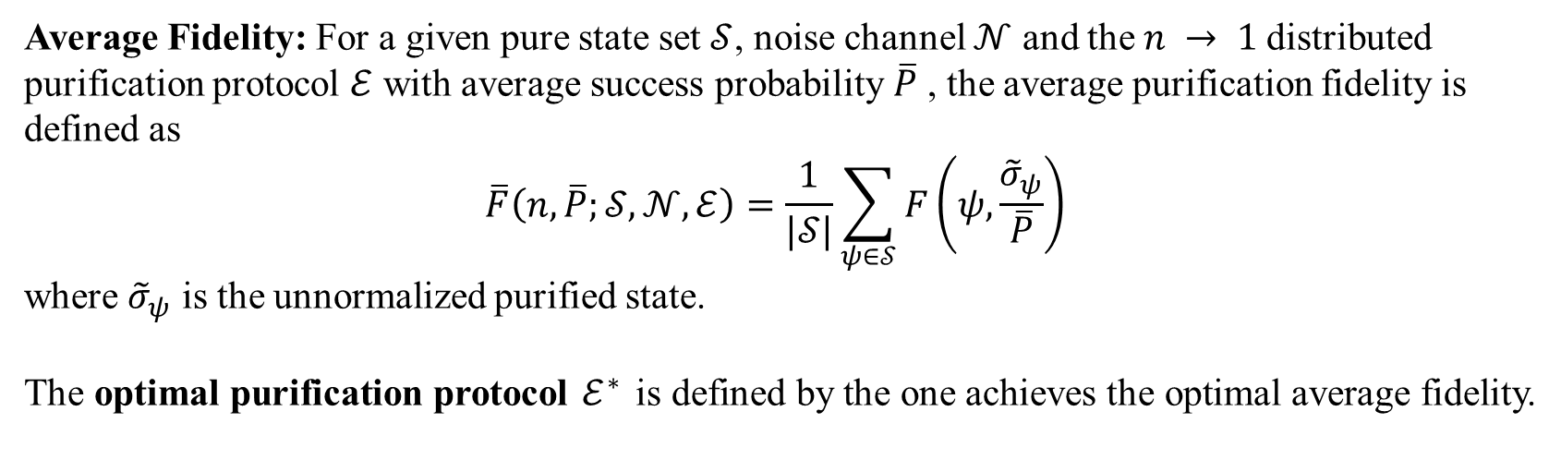
Definitions
The purification protocol is not unique. Which one has the best performance?
Average Fidelity: For a given pure state set $𝒮$, noise channel $𝒩$ and the $n → 1$distributed purification protocol $ℰ$ with average success probability $\overline{P}$ , the average purification fidelity is defined as
$$\overline{F}\left(n,\overline{P};𝒮,𝒩, ℰ\right)=\frac{1}{|𝒮|}\sum_{ψ∈𝒮}{F\left(ψ,\frac{{\tilde{σ}}_{ψ}}{\overline{P}}\right)}$$
where ${\tilde{σ}}_{ψ}$ is the unnormalized purified state.
The optimal purification protocol $ℰ^{∗}$ is defined by the one achieves the optimal average fidelity.
$${\overline{F}}^{∗}\left(n,\overline{P};𝒮,𝒩\right)=\max_{ℰ}\left\{\overline{F} \left(n,\overline{P};𝒮,𝒩,ℰ\right)\right| ℰ∈CPTN ,\frac{1}{\left|S\right|}\sum_{ψ∈𝒮}{Tr\left[ℰ\left(𝒩{\left(ψ\right)}^{⊗n}\right)\right]=\overline{P}}\}$$
Notes:
From the definition, clearly, the purification protocol is not unique. How to judge which one has the best performance

Slide 8







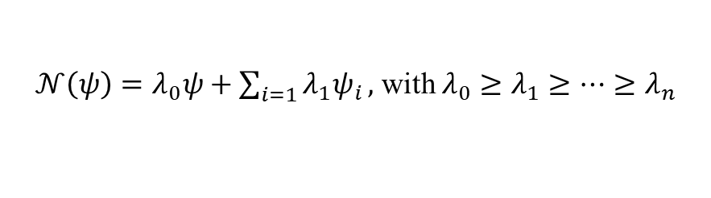


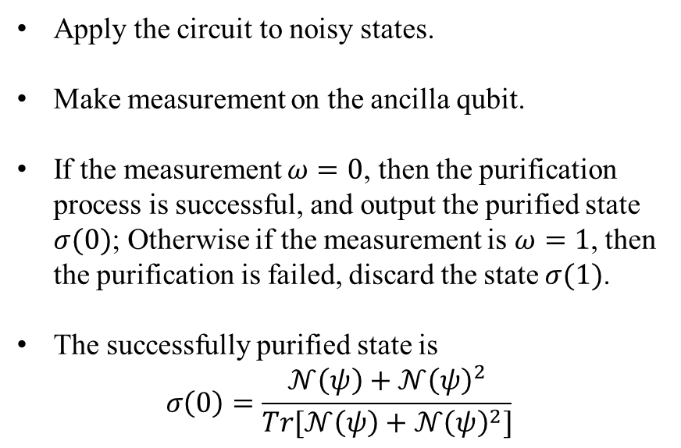




Preliminaries
Example of universal purification protocol
$$ℰ_{swap}$$
$𝒩\left(ψ\right)=λ_{0}ψ+\sum_{i=1}{λ_{1}ψ_{i}},$ with $λ_{0}≥λ_{1}≥⋯≥λ_{n}$
$$|0⟩$$
$$H$$
$$H$$
$$ω$$
$$𝒩(ψ)$$
$$A_{1}$$
$$A′$$
Apply the circuit to noisy states.
Make measurement on the ancilla qubit.
If the measurement $ω=0$, then the purification process is successful, and output the purified state $σ(0)$; Otherwise if the measurement is $ω=1$, then the purification is failed, discard the state $σ(1)$.
The successfully purified state is
$$σ\left(0\right)=\frac{𝒩\left(ψ\right)+𝒩{\left(ψ\right)}^{2}}{Tr[𝒩\left(ψ\right)+𝒩{\left(ψ\right)}^{2}]}$$
$$σ(ω)$$
$$𝒩(ψ)$$
$$A_{2}$$
Single Chip
$$Tr\left[σ\left(0\right)⋅ψ\right]>Tr\left[𝒩\left(ψ\right)⋅ψ\right],∀ψ$$
Notes:
Introduce the figure
Here we study the scenario of distributed quantum computing scenario, such a protocol no longer works as it is hard to implement the control-swap between chips

Slide 9
Preliminaries
Example of universal purification protocol
$$ℰ_{swap}$$
$𝒩\left(ψ\right)=λ_{0}ψ+\sum_{i=1}{λ_{1}ψ_{i}},$ with $λ_{0}≥λ_{1}≥⋯≥λ_{n}$
$$|0⟩$$
$$H$$
$$H$$
$$ω$$
$$𝒩(ψ)$$
$$A_{1}$$
$$A′$$
Apply the circuit to noisy states.
Make measurement on the ancilla qubit.
If the measurement $ω=0$, then the purification process is successful, and output the purified state $σ(0)$; Otherwise if the measurement is $ω=1$, then the purification is failed, discard the state $σ(1)$.
The successfully purified state is
$$σ\left(0\right)=\frac{𝒩\left(ψ\right)+𝒩{\left(ψ\right)}^{2}}{Tr[𝒩\left(ψ\right)+𝒩{\left(ψ\right)}^{2}]}$$
$$σ(ω)$$
$$𝒩(ψ)$$
$$A_{2}$$
Is there a similar protocol for distributed computing?
$$Tr\left[σ\left(0\right)⋅ψ\right]>Tr\left[𝒩\left(ψ\right)⋅ψ\right], ∀ψ$$
Notes:
Therefore it is natural to ask that Is there a similar purification protocol for distributed computing

Slide 10







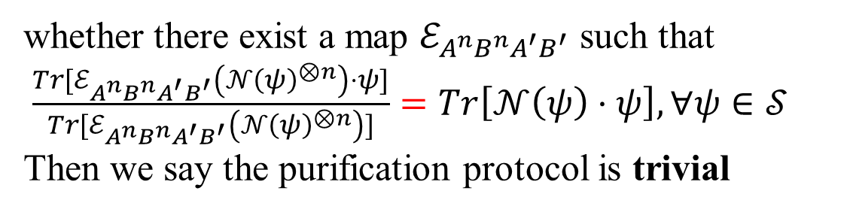



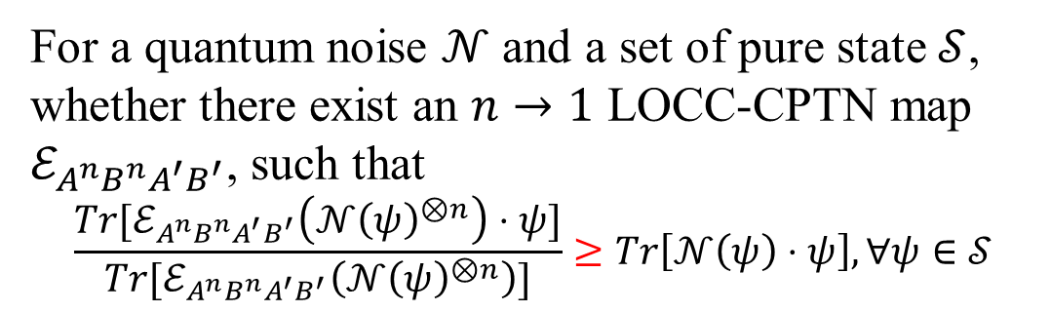




Task
Distributed quantum computing enables spatially separated quantum processors to perform joint computations via local operations and classical communication (LOCC).
$$ℰ_{A^{n}B^{n}A^{′}B^{′}}$$
For a quantum noise $𝒩$ and a set of pure state $𝒮$, whether there exist an $n→1$ LOCC-CPTN map $ℰ_{A^{n}B^{n}A^{′}B^{′}}$, such that
$$\frac{{Tr[ℰ}_{A^{n}B^{n}A^{′}B^{′}}\left(𝒩{\left(ψ\right)}^{⊗n}\right)⋅ψ]}{{Tr[ℰ}_{A^{n}B^{n}A^{′}B^{′}}\left(𝒩{\left(ψ\right)}^{⊗n}\right)]}≥Tr\left[𝒩\left(ψ\right)⋅ψ\right], ∀ψ∈𝒮$$
Alice
$$A_{1}$$
$$O_{A^{n}A^{′}}$$
$$A′$$
$$⋯$$
$$𝒩(ψ)$$
$$A_{n}$$
$$B_{1}$$
$$𝒩(ψ)$$
whether there exist a map $ℰ_{A^{n}B^{n}A^{′}B^{′}}$ such that
$\frac{{Tr[ℰ}_{A^{n}B^{n}A^{′}B^{′}}\left(𝒩{\left(ψ\right)}^{⊗n}\right)⋅ψ]}{{Tr[ℰ}_{A^{n}B^{n}A^{′}B^{′}}\left(𝒩{\left(ψ\right)}^{⊗n}\right)]}=Tr\left[𝒩\left(ψ\right)⋅ψ\right], ∀ψ∈𝒮$
Then we say the purification protocol is trivial
$$⋯$$
$$B′$$
$$O_{B^{n}B^{′}}$$
$$B_{n}$$
Bob

Slide 11





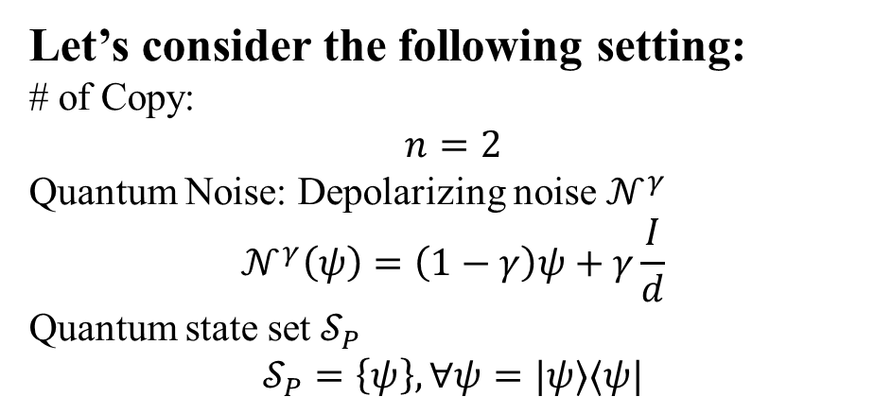



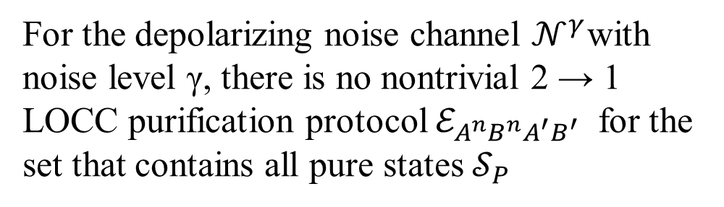



No-go theorem
Let’s consider the following setting:
# of Copy:
$$n=2$$
Quantum Noise: Depolarizing noise $𝒩^{γ}$
$$𝒩^{γ}\left(ψ\right)=\left(1−γ\right)ψ+γ\frac{I}{d}$$
Quantum state set $𝒮_{P}$
$$𝒮_{P}=\left\{ψ\right\}, ∀ψ=|ψ⟩⟨ψ|$$
$$ℰ_{A^{2}B^{2}A^{′}B^{′}}$$
Alice
$$A_{1}$$
$$O_{A^{2}A^{′}}$$
$$A′$$
$$𝒩^{γ}(ψ)$$
$$A_{2}$$
$$B_{1}$$
$$𝒩^{γ}(ψ)$$
Theorem 1
$$B′$$
$$O_{B^{2}B^{′}}$$
For the depolarizing noise channel $𝒩^{γ}$with noise level γ, there is no nontrivial 2 → 1 LOCC purification protocol $ℰ_{A^{n}B^{n}A^{′}B^{′}}$ for the set that contains all pure states $𝒮_{P}$
$$2$$
Bob

Slide 12
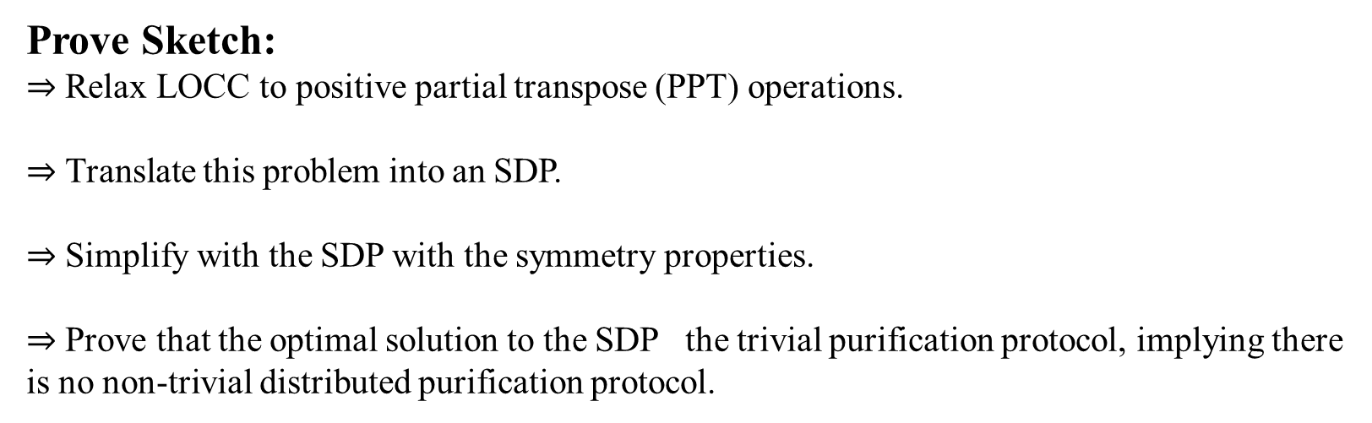
No-go theorem
Theorem 1
For the depolarizing noise channel $𝒩^{γ}$with noise level γ, there is no nontrivial 2 → 1 LOCC purification protocol $ℰ_{A^{n}B^{n}A^{′}B^{′}}$ for the set that contains all pure states $𝒮_{P}$.
Prove Sketch:
$⇒$ Relax LOCC to positive partial transpose (PPT) operations.
$⇒$ Translate this problem into an SDP.
$⇒$ Simplify with the SDP with the symmetry properties.
$⇒$ Prove that the optimal solution to the SDP the trivial purification protocol, implying there is no non-trivial distributed purification protocol.

Slide 13
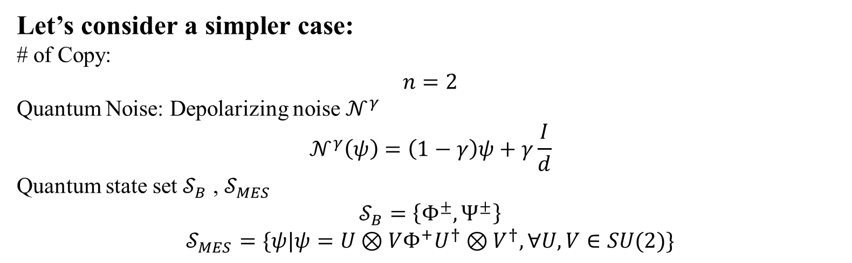
No-go theorem
Let’s consider a simpler case:
# of Copy:
$$n=2$$
Quantum Noise: Depolarizing noise $𝒩^{γ}$
$$𝒩^{γ}\left(ψ\right)=\left(1−γ\right)ψ+γ\frac{I}{d}$$
Quantum state set $𝒮_{B}$ , $𝒮_{MES}$
$$𝒮_{B}=\left\{Φ^{±}, Ψ^{±}\right\}$$
$$𝒮_{MES}=\{ψ|ψ=U⊗VΦ^{+}U^{†}⊗V^{†}, ∀U,V∈SU(2)\}$$

Slide 14
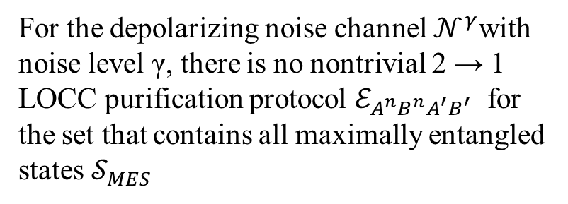
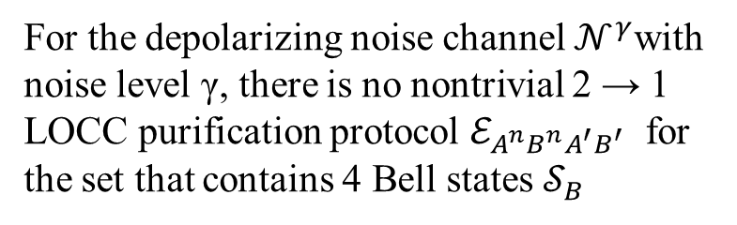
No-go theorem
Let’s consider a simpler case:
# of Copy:
$$n=2$$
Quantum Noise: Depolarizing noise $𝒩^{γ}$
$$𝒩^{γ}\left(ψ\right)=\left(1−γ\right)ψ+γ\frac{I}{d}$$
Quantum state set $𝒮_{B}$ , $𝒮_{MES}$
$$𝒮_{B}=\left\{Φ^{±}, Ψ^{±}\right\}$$
$$𝒮_{MES}=\{ψ|ψ=U⊗VΦ^{+}U^{†}⊗V^{†}, ∀U,V∈SU(2)\}$$
Theorem 2
Theorem 3
For the depolarizing noise channel $𝒩^{γ}$with noise level γ, there is no nontrivial 2 → 1 LOCC purification protocol $ℰ_{A^{n}B^{n}A^{′}B^{′}}$ for the set that contains all maximally entangled states $𝒮_{MES}$
For the depolarizing noise channel $𝒩^{γ}$with noise level γ, there is no nontrivial 2 → 1 LOCC purification protocol $ℰ_{A^{n}B^{n}A^{′}B^{′}}$ for the set that contains 4 Bell states $𝒮_{B}$

Slide 15
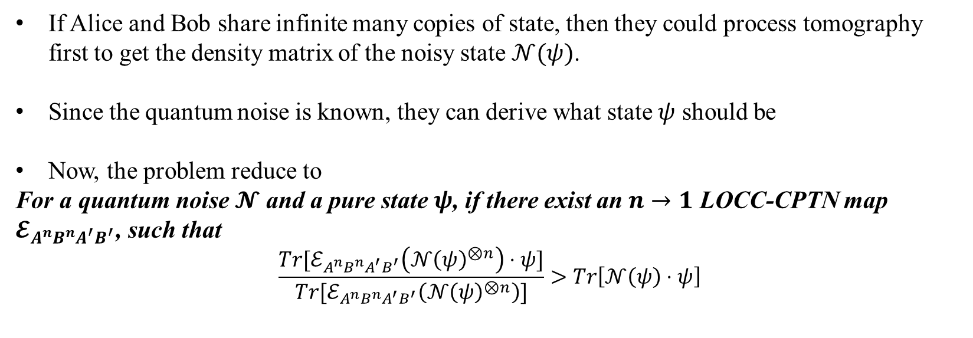
Go theorem
The $2→1$ no-go theorem does not imply the $n→1$ no-go theorem
If Alice and Bob share infinite many copies of state, then they could process tomography first to get the density matrix of the noisy state $𝒩(ψ)$.
Since the quantum noise is known, they can derive what state $ψ$ should be
Now, the problem reduce to
For a quantum noise $𝓝$ and a pure state $ψ$, if there exist an $n→1$ LOCC-CPTN map $𝓔_{A^{n}B^{n}A^{′}B^{′}}$, such that
$$\frac{{Tr[ℰ}_{A^{n}B^{n}A^{′}B^{′}}\left(𝒩{\left(ψ\right)}^{⊗n}\right)⋅ψ]}{{Tr[ℰ}_{A^{n}B^{n}A^{′}B^{′}}\left(𝒩{\left(ψ\right)}^{⊗n}\right)]}>Tr\left[𝒩\left(ψ\right)⋅ψ\right]$$

Slide 16




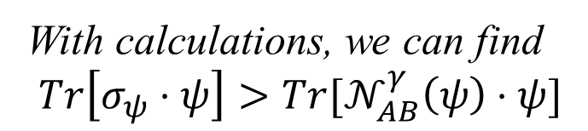



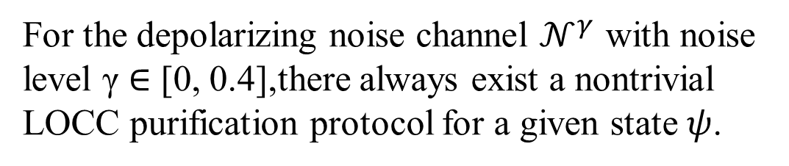











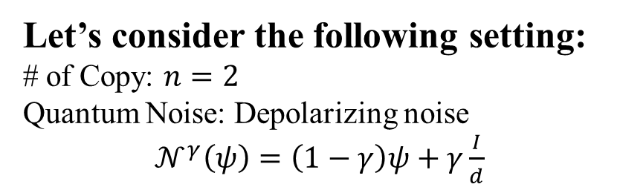
Go theorem
Let’s consider the following setting:
# of Copy: $n=2$
Quantum Noise: Depolarizing noise
$𝒩^{γ}\left(ψ\right)=\left(1−γ\right)ψ+γ\frac{I}{d}$
Theorem 4
For the depolarizing noise channel $𝒩^{γ}$ with noise level γ ∈ [0, 0.4],there always exist a nontrivial LOCC purification protocol for a given state $ψ$.
Alice
$$A_{1}$$
$$A′$$
$$U$$
$$RX\left(\frac{π}{2}\right)$$
$$A_{2}$$
$$U$$
$$0$$
With calculations, we can find
$$Tr\left[σ_{ψ}⋅ψ\right]>{Tr[𝒩}_{AB}^{γ}\left(ψ\right)⋅ψ]$$
$$𝒩_{AB}^{γ}(ψ)$$
$$σ_{ψ}$$
$$𝒩_{AB}^{γ}(ψ)$$
$$B_{1}$$
$$V$$
$$RX\left(−\frac{π}{2}\right)$$
$$B_{2}$$
$$B′$$
$$V$$
$$0$$
Bob
$$U⊗V\left(ψ\right)=α\left|00\right\rangle +β|11⟩$$

Slide 17
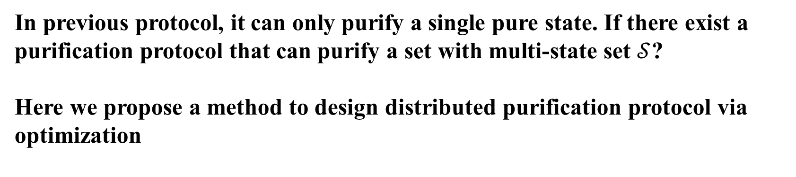
Purification protocol with optimization
In previous protocol, it can only purify a single pure state. If there exist a purification protocol that can purify a set with multi-state set $𝒮$?
Here we propose a method to design distributed purification protocol via optimization

Slide 18

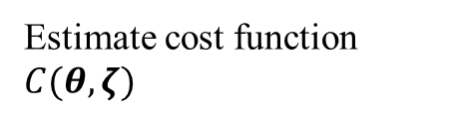








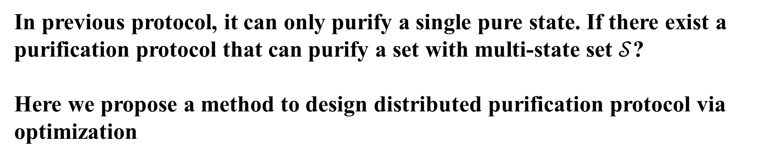
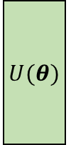





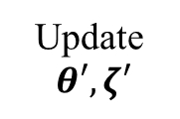

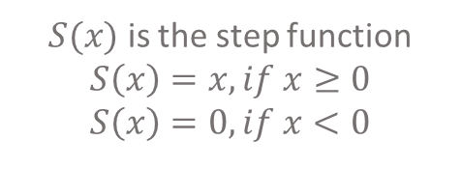




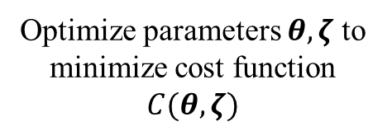

Purification protocol with optimization
In previous protocol, it can only purify a single pure state. If there exist a purification protocol that can purify a set with multi-state set $𝒮$?
Here we propose a method to design distributed purification protocol via optimization
Alice
$$A_{1}$$
$$A′$$
$C\left(θ,ζ\right)=−\sum_{ψ∈𝒮}{F\left(ψ,σ_{ψ}\right)+α\sum_{ψ∈𝒮}{\left(S\left(F\left(ψ,𝒩\left(ψ\right)\right)−F\left(ψ,σ_{ψ}\right)\right)\right)}}$
$$U(θ)$$
$$A_{2}$$
$$0$$
$$⋮$$
$S(x)$ is the step function
$S\left(x\right)=x, if x≥0$
$S\left(x\right)=0, if x<0$
$$𝒩_{AB}^{γ}(ψ)$$
$$A_{n}$$
$$σ_{ψ}$$
Estimate cost function $C(θ,ζ)$
$$0$$
$$𝒩_{AB}^{γ}(ψ)$$
$$⋮$$
$$B′$$
$$B_{1}$$
$$𝒩_{AB}^{γ}(ψ)$$
$$B_{2}$$
$$V(ζ)$$
$$0$$
Optimize parameters $θ,ζ$ to
minimize cost function $C(θ,ζ)$
$$⋮$$
Update$θ′,ζ′$
$$B_{n}$$
$$0$$
Bob

Slide 19
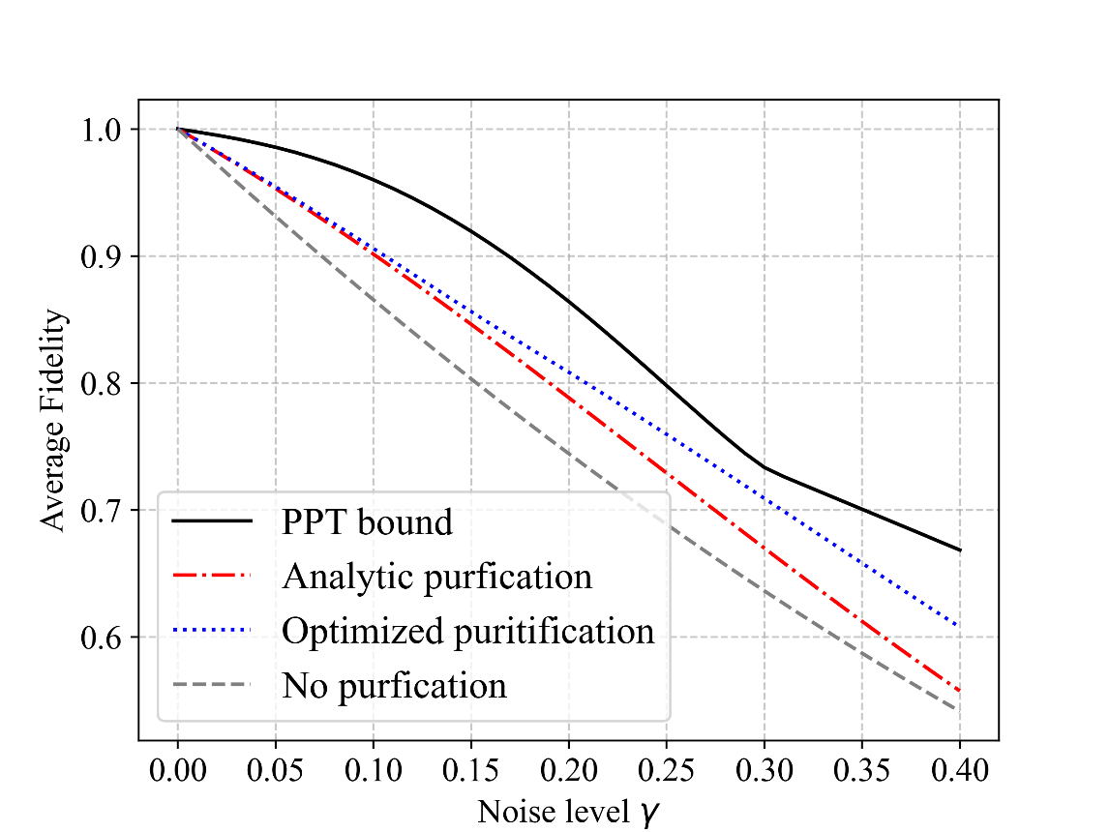

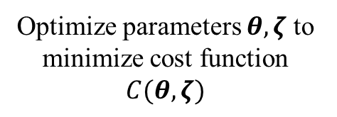

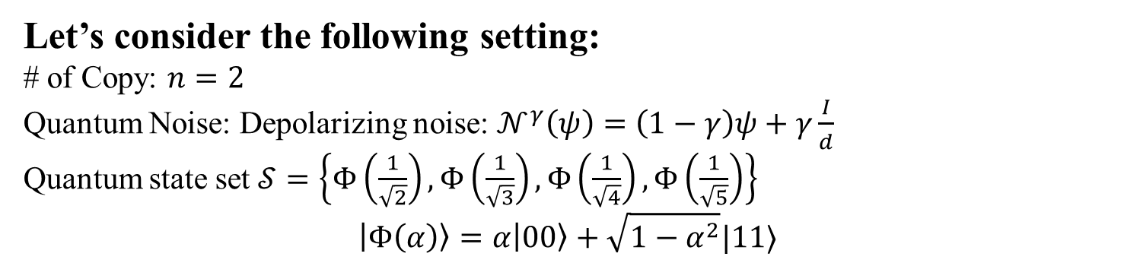



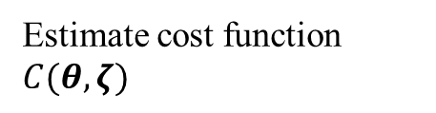









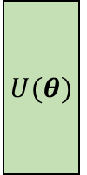





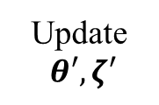

Purification protocol with optimization
Let’s consider the following setting:
# of Copy: $n=2$
Quantum Noise: Depolarizing noise: $𝒩^{γ}\left(ψ\right)=\left(1−γ\right)ψ+γ\frac{I}{d}$
Quantum state set $𝒮=\left\{Φ\left(\frac{1}{\sqrt{2}}\right),Φ\left(\frac{1}{\sqrt{3}}\right),Φ\left(\frac{1}{\sqrt{4}}\right),Φ\left(\frac{1}{\sqrt{5}}\right)\right\}$
$$\left|Φ\left(α\right)\right\rangle =α\left|00\right\rangle +\sqrt{1−α^{2}}|11⟩$$
Alice
$$A_{1}$$
$$A′$$
$$U(θ)$$
$$A_{2}$$
$$0$$
$$⋮$$
Estimate cost function $C(θ,ζ)$
$$𝒩_{AB}^{γ}(ψ)$$
$$A_{n}$$
$$σ_{ψ}$$
$$0$$
$$𝒩_{AB}^{γ}(ψ)$$
$$⋮$$
$$B′$$
$$B_{1}$$
$$𝒩_{AB}^{γ}(ψ)$$
$$B_{2}$$
$$V(ζ)$$
$$0$$
Optimize parameters $θ,ζ$ to
minimize cost function $C(θ,ζ)$
$$⋮$$
Update$θ′,ζ′$
$$B_{n}$$
$$0$$
Bob

Slide 20
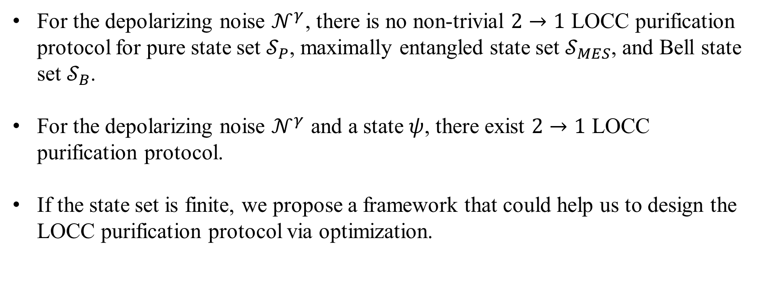
Conclusion
For the depolarizing noise $𝒩^{γ}$, there is no non-trivial $2→1$ LOCC purification protocol for pure state set $𝒮_{P}$, maximally entangled state set $𝒮_{MES}$, and Bell state set $𝒮_{B}$.
For the depolarizing noise $𝒩^{γ}$ and a state $ψ$, there exist $2→1$ LOCC purification protocol.
If the state set is finite, we propose a framework that could help us to design the LOCC purification protocol via optimization.

Slide 21



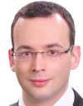

Thank you for your attention!
Yu-Ao Chen
Xuanqiang Zhao
Chengkai Zhu
Giulio Chiribella
Xin Wang

Slide 22
Content
Background & Motivation
Definitions & Task
No-Go Theorem for universal distributed purification
Go Theorem for distributed purification
Purification protocol via optimization

Slide 23
Definitions
The purification protocol is not unique. Which one has the best performance?
Average Fidelity: For a given pure state set $𝒮$, noise channel $𝒩$ and the $n → 1$distributed purification protocol $ℰ$ with average success probability $\overline{P}$ , the average purification fidelity is defined as
$$\overline{F}\left(n,\overline{P};𝒮,𝒩, ℰ\right)=\frac{1}{|𝒮|}\sum_{ψ∈𝒮}{F\left(ψ,\frac{{\tilde{σ}}_{ψ}}{\overline{P}}\right)}$$
where ${\tilde{σ}}_{ψ}$ is the unnormalized purified state.
The optimal purification protocol $ℰ^{∗}$ is defined by the one achieves the optimal average fidelity.
$${\overline{F}}^{∗}\left(n,\overline{P};𝒮,𝒩\right)=\max_{ℰ}\left\{\overline{F} \left(n,\overline{P};𝒮,𝒩,ℰ\right)\right| ℰ∈LOCC∩CPTN ,\frac{1}{\left|S\right|}\sum_{ψ∈𝒮}{Tr\left[ℰ\left(𝒩{\left(ψ\right)}^{⊗n}\right)\right]=\overline{P }}\}$$
Notes:
In our case, we are talking about distributed quantum computing, thus we have constraint the operations to LOCC

Slide 24
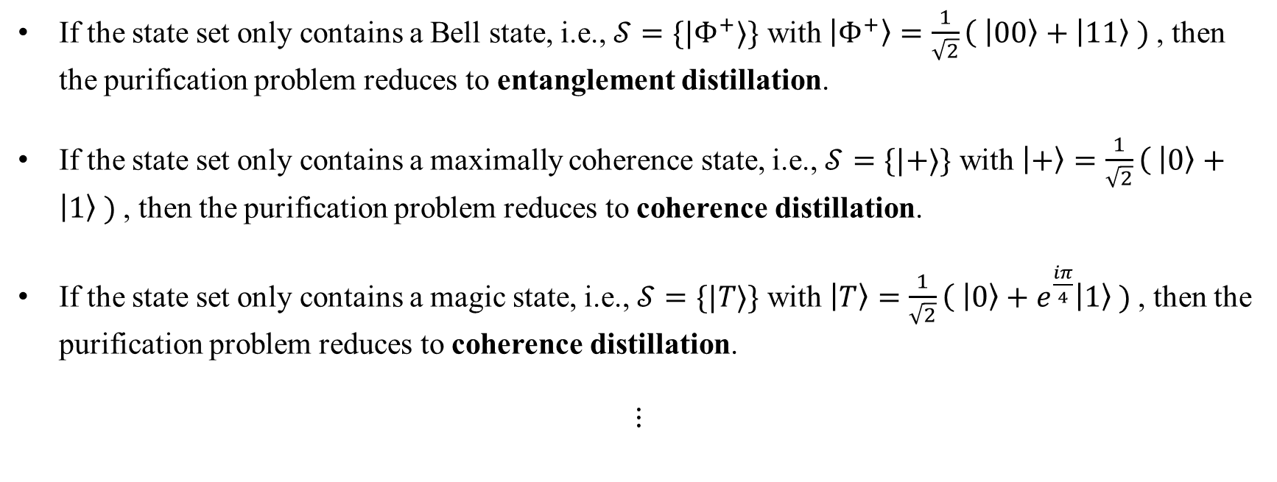
Definitions
Quantum state purification can reduce the resource distillation
If the state set only contains a Bell state, i.e., $𝒮=\{|Φ^{+}⟩\}$ with $\left|Φ^{+}\right\rangle =\frac{1}{\sqrt{2}}\left( | 00\right\rangle +\left|11\right\rangle )$, then the purification problem reduces to entanglement distillation.
If the state set only contains a maximally coherence state, i.e., $𝒮=\{|+⟩\}$ with $\left|+\right\rangle =\frac{1}{\sqrt{2}}\left( | 0\right\rangle +\left|1\right\rangle )$, then the purification problem reduces to coherence distillation.
If the state set only contains a magic state, i.e., $𝒮=\{|T⟩\}$ with $\left|T\right\rangle =\frac{1}{\sqrt{2}}\left( | 0\right\rangle +e^{\frac{iπ}{4}}\left|1\right\rangle )$, then the purification problem reduces to coherence distillation.
$$⋮$$
Notes:
For some special state set, the quantum state purification can reduce the resource distillation

Slide 25
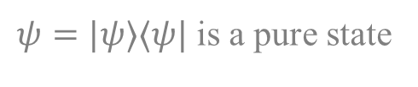







Background & Motivation
Quantum systems usually suffer from unwanted interactions with the environment
$$ψ_{env}$$
$$U$$
$ψ=|ψ⟩⟨ψ|$ is a pure state
$$ψ$$
Noises can be modeled as quantum channels (completely positive and trace-preserving (CPTP) maps)
$$𝒩$$
$$ψ$$
$$𝒩\left(ψ\right)$$
For example, a depolarizing channel is a common noise model in quantum computing which maps quantum state into identity probabilistically
$$𝒩\left(ψ\right)=\left(1−p\right)ψ+p\frac{I}{2}$$
where $0≤p≤1$

Slide 26
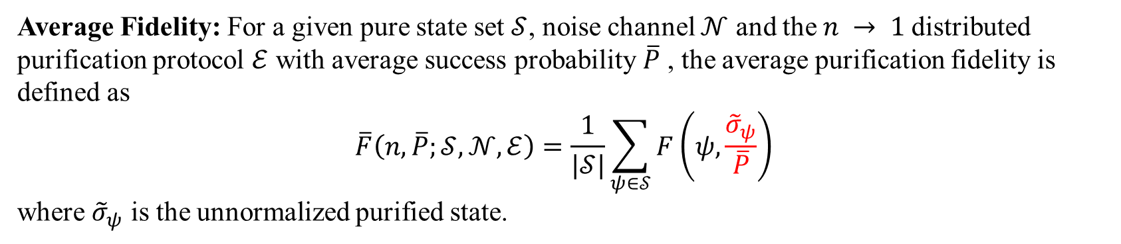
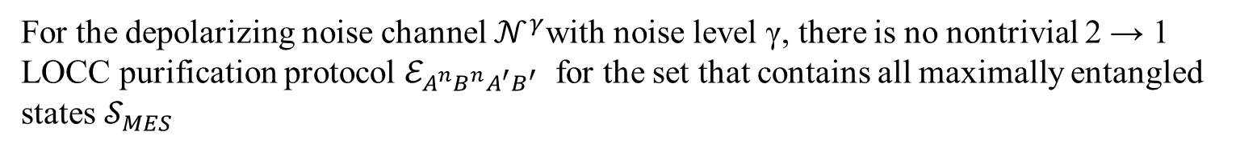
No-go theorem
Theorem 2
For the depolarizing noise channel $𝒩^{γ}$with noise level γ, there is no nontrivial 2 → 1 LOCC purification protocol $ℰ_{A^{n}B^{n}A^{′}B^{′}}$ for the set that contains all maximally entangled states $𝒮_{MES}$
The idea is to prove the optimal is trivial.
What is optimal?
Average Fidelity: For a given pure state set $𝒮$, noise channel $𝒩$ and the $n → 1$distributed purification protocol $ℰ$ with average success probability $\overline{P}$ , the average purification fidelity is defined as
$$\overline{F}\left(n,\overline{P};𝒮,𝒩, ℰ\right)=\frac{1}{|𝒮|}\sum_{ψ∈𝒮}{F\left(ψ,\frac{{\tilde{σ}}_{ψ}}{\overline{P}}\right)}$$
where ${\tilde{σ}}_{ψ}$ is the unnormalized purified state.
Why?

Slide 27
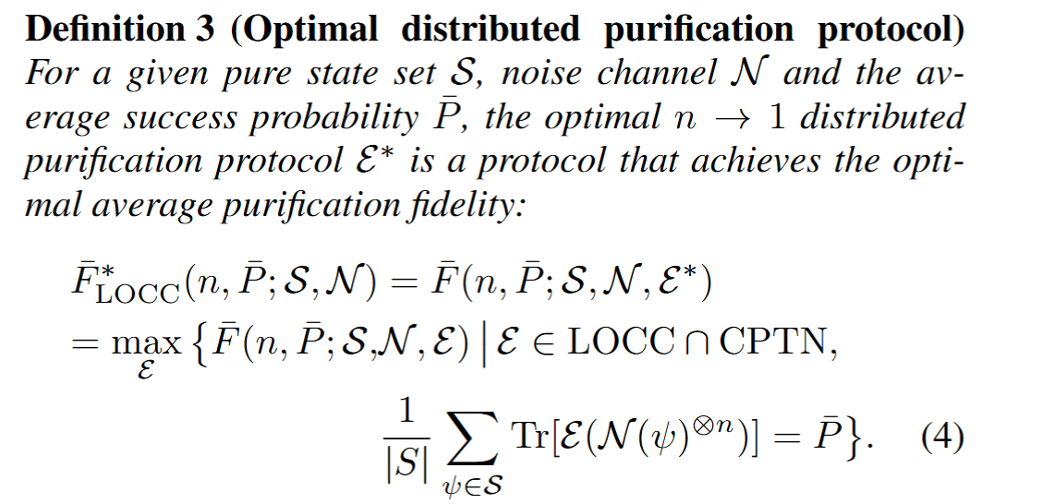



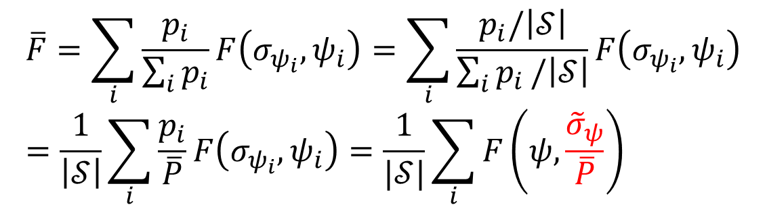










No-go theorem
$$p_{1}$$
$${σ_{ψ}}_{1}$$
$$ψ_{1}$$
$$F\left(σ_{ψ_{1}},ψ_{1}\right)$$
$$p_{2}$$
$${σ_{ψ}}_{2}$$
$$ψ_{2}$$
$$F\left(σ_{ψ_{2}},ψ_{2}\right)$$
$$⋯$$
$$p_{n}$$
$${σ_{ψ}}_{n}$$
$$ψ_{n}$$
$$F\left(σ_{ψ_{n}},ψ_{n}\right)$$
$$\overline{F}=\sum_{i}{\frac{p_{i}}{\sum_{i}{p_{i}}}}F\left(σ_{ψ_{i}},ψ_{i}\right)=\sum_{i}{\frac{p_{i}/\left|𝒮\right|}{\sum_{i}{p_{i}}/\left|𝒮\right|}}F\left(σ_{ψ_{i}},ψ_{i}\right)=\frac{1}{\left|𝒮\right|}\sum_{i}{\frac{p_{i}}{\overline{P}}}F\left(σ_{ψ_{i}},ψ_{i}\right)=\frac{1}{|𝒮|}\sum_{i}{F\left(ψ,\frac{{\tilde{σ}}_{ψ}}{\overline{P}}\right)}$$

Slide 28
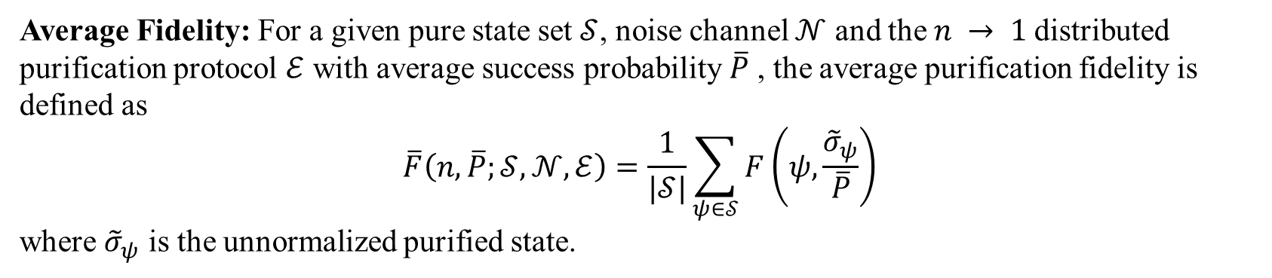
No-go theorem
Theorem 2
For the depolarizing noise channel $𝒩^{γ}$with noise level γ, there is no nontrivial 2 → 1 LOCC purification protocol $ℰ_{A^{n}B^{n}A^{′}B^{′}}$ for the set that contains all maximally entangled states $𝒮_{MES}$
The idea is to prove the optimal is trivial.
What is optimal?
Average Fidelity: For a given pure state set $𝒮$, noise channel $𝒩$ and the $n → 1$distributed purification protocol $ℰ$ with average success probability $\overline{P}$ , the average purification fidelity is defined as
$$\overline{F}\left(n,\overline{P};𝒮,𝒩, ℰ\right)=\frac{1}{|𝒮|}\sum_{ψ∈𝒮}{F\left(ψ,\frac{{\tilde{σ}}_{ψ}}{\overline{P}}\right)}$$
where ${\tilde{σ}}_{ψ}$ is the unnormalized purified state.

Slide 29
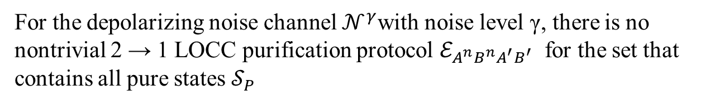
No-go theorem
Theorem 1
For the depolarizing noise channel $𝒩^{γ}$with noise level γ, there is no nontrivial 2 → 1 LOCC purification protocol $ℰ_{A^{n}B^{n}A^{′}B^{′}}$ for the set that contains all pure states $𝒮_{P}$
Prove Sketch:
Simplify the constraints via the symmetry of the state set, and we achieve a semidefinite program to calculate the optimal average fidelity achieved by the optimal purification.
We found that the optimal purification protocol is trivial.

Slide 30
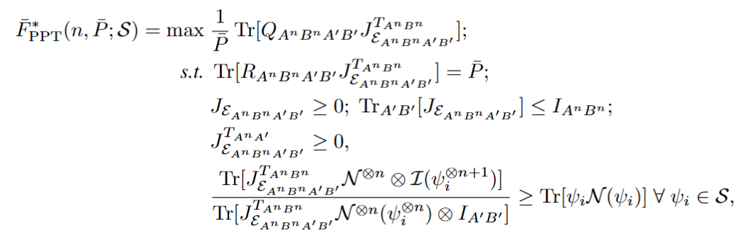
No-go theorem
Theorem 2
For the depolarizing noise channel $𝒩^{γ}$with noise level γ, there is no nontrivial 2 → 1 LOCC purification protocol $ℰ_{A^{n}B^{n}A^{′}B^{′}}$ for the set that contains all maximally entangled states $𝒮_{MES}$
Step 1: Relax the LOCC operation to PPT
Step 2: Obtain the SDP for optimal distributed purification protocol

Slide 31

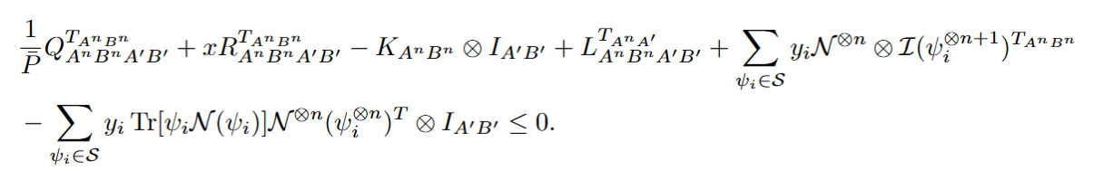
No-go theorem
Theorem 2
For the depolarizing noise channel $𝒩^{γ}$with noise level γ, there is no nontrivial 2 → 1 LOCC purification protocol $ℰ_{A^{n}B^{n}A^{′}B^{′}}$ for the set that contains all maximally entangled states $𝒮_{MES}$
Step 3: Calculate the Dual SDP

Slide 32
No-go theorem
Theorem 2
For the depolarizing noise channel $𝒩^{γ}$with noise level γ, there is no nontrivial 2 → 1 LOCC purification protocol $ℰ_{A^{n}B^{n}A^{′}B^{′}}$ for the set that contains all maximally entangled states $𝒮_{MES}$
Step 4: Give the optimal purification protocol and found that the optimal one is trivial, which cannot increase the fidelity

Slide 33
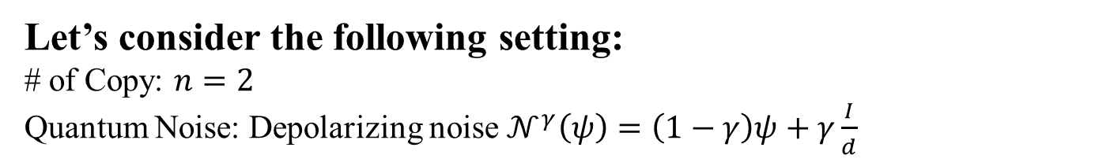
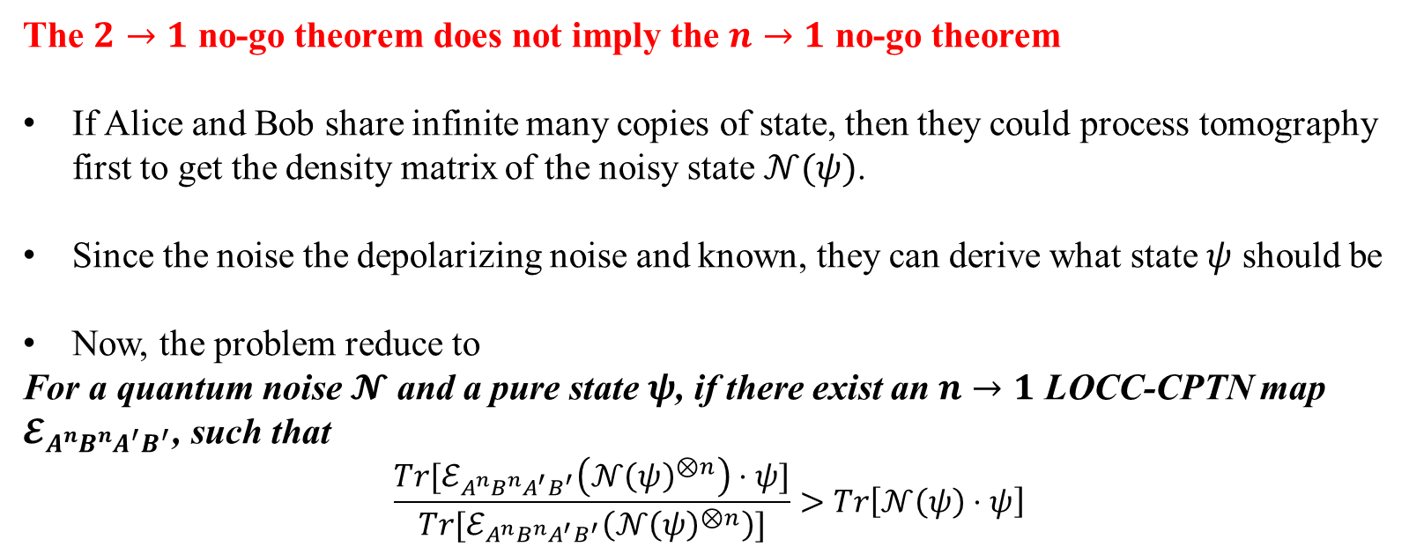
Go theorem
The $2→1$ no-go theorem does not imply the $n→1$ no-go theorem
If Alice and Bob share infinite many copies of state, then they could process tomography first to get the density matrix of the noisy state $𝒩(ψ)$.
Since the noise the depolarizing noise and known, they can derive what state $ψ$ should be
Now, the problem reduce to
For a quantum noise $𝓝$ and a pure state $ψ$, if there exist an $n→1$ LOCC-CPTN map $𝓔_{A^{n}B^{n}A^{′}B^{′}}$, such that
$$\frac{{Tr[ℰ}_{A^{n}B^{n}A^{′}B^{′}}\left(𝒩{\left(ψ\right)}^{⊗n}\right)⋅ψ]}{{Tr[ℰ}_{A^{n}B^{n}A^{′}B^{′}}\left(𝒩{\left(ψ\right)}^{⊗n}\right)]}>Tr\left[𝒩\left(ψ\right)⋅ψ\right]$$
Let’s consider the following setting:
# of Copy: $n=2$
Quantum Noise: Depolarizing noise $𝒩^{γ}\left(ψ\right)=\left(1−γ\right)ψ+γ\frac{I}{d}$

Slide 34
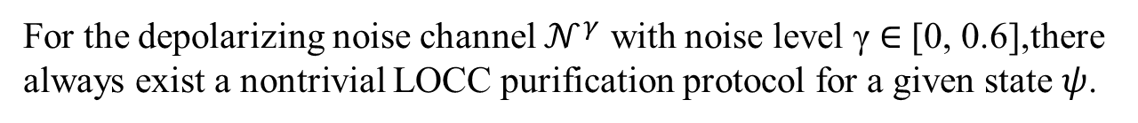
Go theorem
Theorem 4
For the depolarizing noise channel $𝒩^{γ}$ with noise level γ ∈ [0, 0.6],there always exist a nontrivial LOCC purification protocol for a given state $ψ$.

