Slide 1

Work extraction
Quantum System:
(Degenerate Hamiltonian)
$$σ$$
Notes:
Explain everything

Slide 2
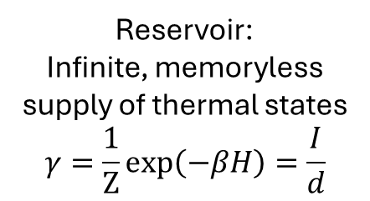
Work extraction
Quantum System:
(Degenerate Hamiltonian)
$$σ$$
Reservoir:
Infinite, memoryless supply of thermal states $$γ=\frac{1}{Z}exp\left(−βH\right)=\frac{I}{d}$$
R
Notes:
Explain everything

Slide 3
Work extraction
Quantum System:
(Degenerate Hamiltonian)
(Not thermal state)
$$σ$$
Reservoir:
Infinite, memoryless supply of thermal states $$γ=\frac{1}{Z}exp\left(−βH\right)=\frac{I}{d}$$
R
Notes:
Explain everything

Slide 4




Work extraction
Quantum System:
(Degenerate Hamiltonian)
(Not thermal state)
$$σ$$
$$γ$$
Reservoir:
Infinite, memoryless supply of thermal states $$γ=\frac{1}{Z}exp\left(−βH\right)=\frac{I}{d}$$
Thermal operation
R
R
Battery
$$\left\langle W\right\rangle =F_{noneq}\left(σ\right)=β^{−1}S\left(σ‖γ\right)$$

Slide 5

Work extraction
Quantum System:
(Degenerate Hamiltonian)
(Not thermal state)
$$σ$$
$$γ$$
Reservoir:
Infinite, memoryless supply of thermal states $$γ=\frac{1}{Z}exp\left(−βH\right)=\frac{I}{d}$$
Thermal operation
R
R
Battery
Degenerate $H⇒$Purity is a resource
Notes:
Explain everything

Slide 6
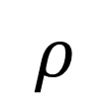
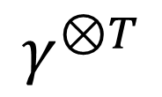
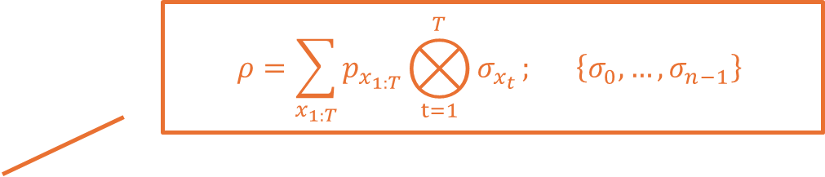
Work extraction
$$ρ=\sum_{x_{1:T}}{p_{x_{1:T}}}⨂_{t=1}^{T}{σ_{x_{t}}}; \left\{σ_{0},…,σ_{n−1}\right\}$$
Quantum System:
(Degenerate Hamiltonian)
(Not thermal state— purity is a resource)
$$ρ$$
$$γ^{⊗T}$$
Reservoir:
Infinite, memoryless supply of thermal states $$γ=\frac{1}{Z}exp\left(−βH\right)=\frac{I}{d}$$
Thermal operation
R
R
Battery
$\left\langle W\right\rangle =F_{noneq}\left(ρ\right)=β^{−1}S\left(ρ‖ γ^{⊗T} \right)≥$ $β^{−1}S\left(ρ_{1}⊗…⊗ρ_{N}‖ γ^{⊗T} \right)$
Correlation is also a resource

Slide 7
Work extraction
$$ρ=\sum_{x_{1:T}}{p_{x_{1:T}}}⨂_{t=1}^{T}{σ_{x_{t}}}; \left\{σ_{0},…,σ_{n−1}\right\}$$
Quantum System:
(Degenerate Hamiltonian)
(Not thermal state— purity is a resource)
$$ρ$$
$$γ^{⊗T}$$
Reservoir:
Infinite, memoryless supply of thermal states $$γ=\frac{1}{Z}exp\left(−βH\right)=\frac{I}{d}$$
Thermal operation
R
R
Battery
$\left\langle W\right\rangle =F_{noneq}\left(ρ\right)=β^{−1}S\left(ρ‖ γ^{⊗T} \right)≥$ $β^{−1}S\left(ρ_{1}⊗…⊗ρ_{N}‖ γ^{⊗T} \right)$
However, difficult to preserve and operate on multipartite state

Slide 8



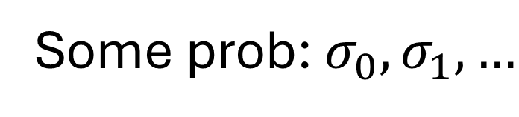
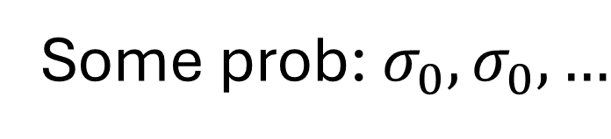
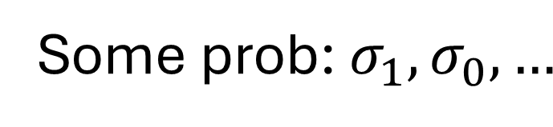
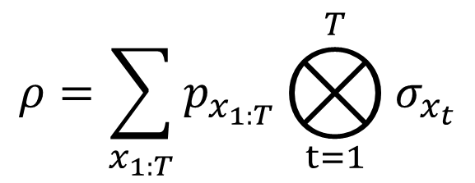
Detour: Hidden Markov Model Generated Correlations
$$ρ=\sum_{x_{1:T}}{p_{x_{1:T}}}⨂_{t=1}^{T}{σ_{x_{t}}}$$
$$=$$
Some prob: $σ_{1},σ_{0},…$
Some prob: $σ_{0},σ_{0},…$
Some prob: $σ_{0},σ_{1},…$
$$…$$
Travers, N. F., & Crutchfield, J. P. (2011). Journal of Statistical Physics, 145(5), 1181-1201.
Notes:
Emphasize that the HMM is only for illustration, but explain how they have transition probabilities

Slide 9
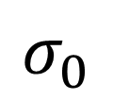

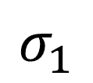

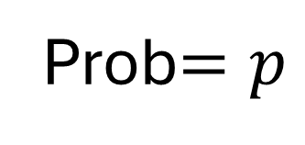
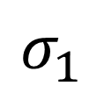
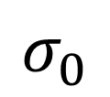



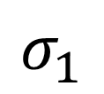

Example
Prob$=p$
Many states
$$σ_{1}$$
$$σ_{0}$$
$$σ_{1}$$
$$σ_{1}$$
$$σ_{0}$$
$$⋯$$
Time
1
2
3
4
5
$$⋯$$

Slide 10


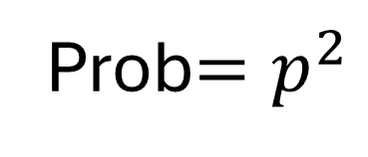


Example
Prob$=p^{2}$
Many states
$$σ_{1}$$
$$σ_{0}$$
$$σ_{1}$$
$$σ_{1}$$
$$σ_{0}$$
$$⋯$$
Time
1
2
3
4
5
$$⋯$$

Slide 11
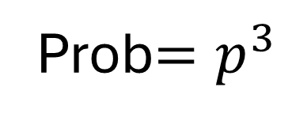
Example
Prob$=p^{3}$
Many states
$$σ_{1}$$
$$σ_{0}$$
$$σ_{1}$$
$$σ_{1}$$
$$σ_{0}$$
$$⋯$$
Time
1
2
3
4
5
$$⋯$$

Slide 12


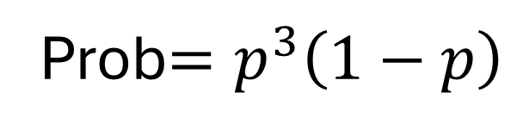


Example
Prob$=p^{3}\left(1−p\right)$
Many states
$$σ_{1}$$
$$σ_{0}$$
$$σ_{1}$$
$$σ_{1}$$
$$σ_{0}$$
$$⋯$$
Time
1
2
3
4
5
$$⋯$$

Slide 13
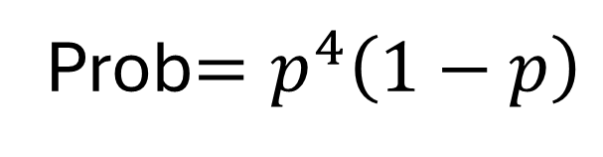
Example
Prob$=p^{4}\left(1−p\right)$
Many states
$$σ_{1}$$
$$σ_{0}$$
$$σ_{1}$$
$$σ_{1}$$
$$σ_{0}$$
$$⋯$$
Time
1
2
3
4
5
$$⋯$$

Slide 14
Hidden Markov Model Generated Correlations
$$ρ=\sum_{x_{1:T}}{p_{x_{1:T}}}⨂_{t=1}^{T}{σ_{x_{t}}}$$
$$=$$
Some prob: $σ_{1},σ_{0},…$
Some prob: $σ_{0},σ_{0},…$
Some prob: $σ_{0},σ_{1},…$
$$…$$
Travers, N. F., & Crutchfield, J. P. (2011). Journal of Statistical Physics, 145(5), 1181-1201.
Notes:
Emphasize that the HMM is only for illustration, but explain how they have transition probabilities

Slide 15
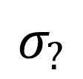
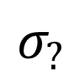

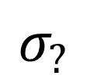
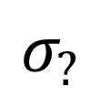
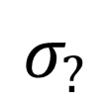
HMM creates a stream of states as fuel
Many quantum states
$$σ_{?}$$
$$σ_{?}$$
$$σ_{?}$$
$$σ_{?}$$
$$σ_{?}$$
$$⋯$$
Reservoir
Many batteries
$$⋯$$
Time
1
2
3
4
5
$$⋯$$

Slide 16


Stream of states as fuel
An agent
Thermal Operation $ℰ$
Many quantum states
$$σ_{?}$$
$$σ_{?}$$
$$σ_{?}$$
$$σ_{?}$$
$$σ_{?}$$
$$⋯$$
Reservoir
Many batteries
$$⋯$$
Time
1
2
3
4
5
$$⋯$$

Slide 17

Stream of states as fuel
An agent
Thermal Operation $ℰ′$
Many quantum states
$$σ_{?}$$
$$σ_{?}$$
$$σ_{?}$$
$$σ_{?}$$
$$σ_{?}$$
$$⋯$$
Reservoir
Many batteries
$$⋯$$
Time
1
2
3
4
5
$$⋯$$

Slide 18
$W=F_{noneq}\left(ρ\right)=β^{−1}S\left(ρ‖ γ^{⊗T} \right)≥$ $β^{−1}S\left(ρ_{1}⊗…⊗ρ_{N}‖ γ^{⊗T} \right)$
I don’t want to just extract from marginal states! How to tap into the correlations?

Slide 19
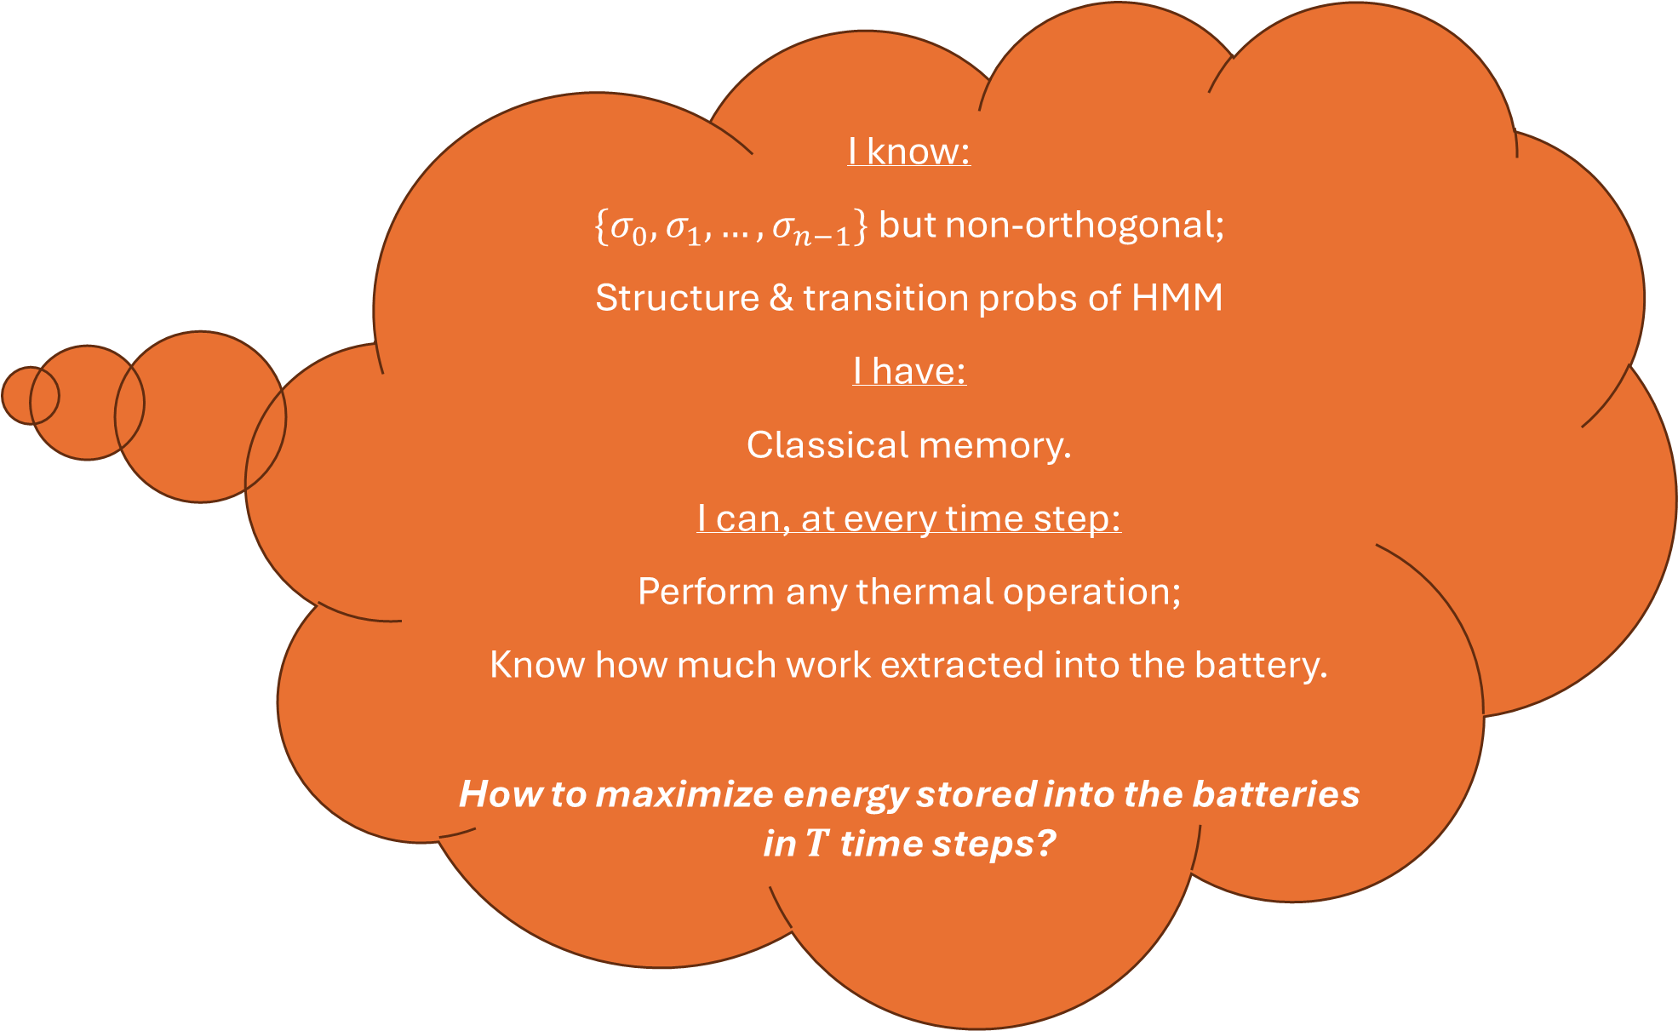
I know:
$\{σ_{0},σ_{1},…,σ_{n−1}\}$ but non-orthogonal;
Structure & transition probs of HMM
I have:
Classical memory.
I can, at every time step:
Perform any thermal operation;
Know how much work extracted into the battery.
How to maximize energy stored into the batteries in $T$ time steps?
Our Problem:
Assume that measurements in the energy eigenbasis of the battery can be done without extra cost
Notes:
Explain everything

Slide 20

I know:
$\{σ_{0},σ_{1},…,σ_{n−1}\}$ but non-orthogonal;
HMM generating the time series of states.
I have:
Classical memory.
I can, at every time step:
Perform any thermal operation;
Know how much work extracted into the battery.
How to get as much energy stored in the batteries as possible in time T?
Our Problem:
One sentence summary:
Trade-off for operational feasibility: Causal constraint—the agent can only look into the past

Slide 21
1st Strategy: Greed is good [1]
[1] Huang, R. C., Riechers, P. M., Gu, M., & Narasimhachar, V. (2023). Quantum, 7, 1203.

Slide 22
Greed is good [1]
Analyse:
[1] Huang, R. C., Riechers, P. M., Gu, M., & Narasimhachar, V. (2023). Quantum, 7, 1203.

Slide 23
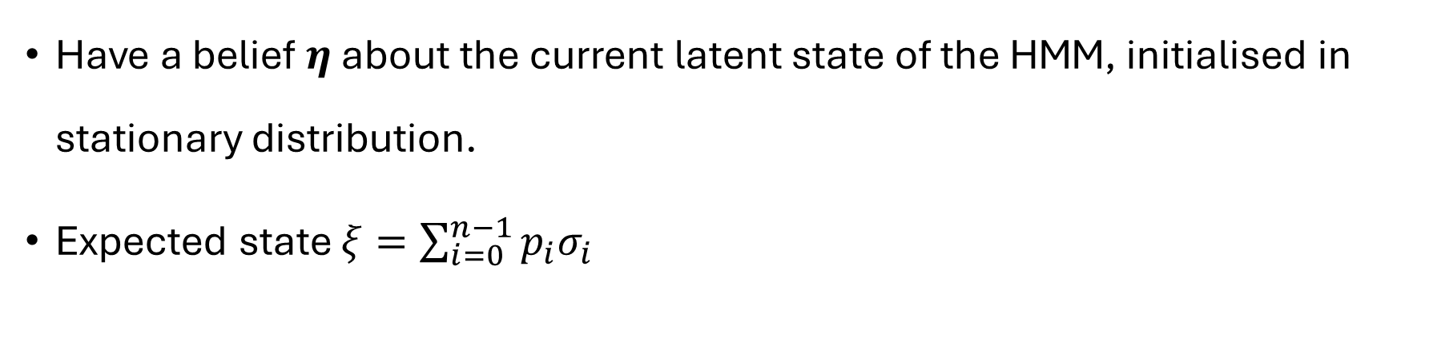
Greed is good [1]
Have a belief $η$ about the current latent state of the HMM, initialised in stationary distribution.
Expected state $ξ=\sum_{i=0}^{n−1}{p_{i}σ_{i}}$
[1] Huang, R. C., Riechers, P. M., Gu, M., & Narasimhachar, V. (2023). Quantum, 7, 1203.

Slide 24
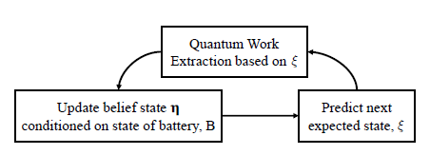
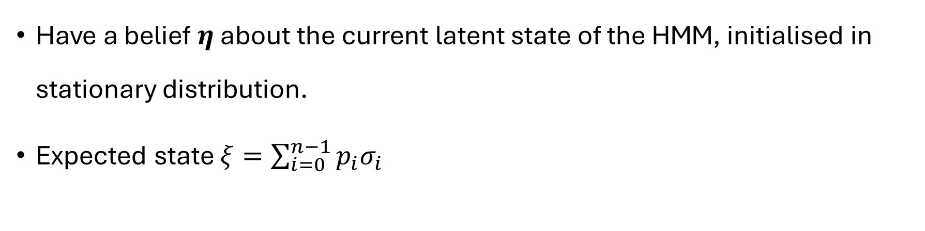
Greed is good [1]
From [1]
Have a belief $η$ about the current latent state of the HMM, initialised in stationary distribution.
Expected state $ξ=\sum_{i=0}^{n−1}{p_{i}σ_{i}}$
[1] Huang, R. C., Riechers, P. M., Gu, M., & Narasimhachar, V. (2023). Quantum, 7, 1203.

Slide 25
Greed is good [1]
WHAT DOES IT MEAN?
From [1]
Have a belief $η$ about the current latent state of the HMM, initialised in stationary distribution.
Expected state $ξ=\sum_{i=0}^{n−1}{p_{i}σ_{i}}$
[1] Huang, R. C., Riechers, P. M., Gu, M., & Narasimhachar, V. (2023). Quantum, 7, 1203.

Slide 26

We can have the extraction tailored to $ρ$ while the actual incoming state is $σ_{i}$:
$$β\left\langle W\right\rangle {\left.​\right|}_{in: σ_{i}, tl: ρ} =S\left(σ_{i}∣∣γ\right)−S\left(σ_{i}∣∣ρ\right)$$
Riechers, P. M., & Gu, M. (2021). Physical Review E, 103(4), 042145.

Slide 27

We can have the extraction tailored to $ρ$ while the actual incoming state is $σ_{i}$:
$$β\left\langle W\right\rangle {\left.​\right|}_{in: σ_{i}, tl: ρ} =S\left(σ_{i}∣∣γ\right)−S\left(σ_{i}∣∣ρ\right)$$
If we tailor to the actual incoming state:
$$β\left\langle W\right\rangle {\left.​\right|}_{in: σ_{i}, tl:σ_{i}} =S\left(σ_{i}∣∣γ\right)$$
Riechers, P. M., & Gu, M. (2021). Physical Review E, 103(4), 042145.

Slide 28
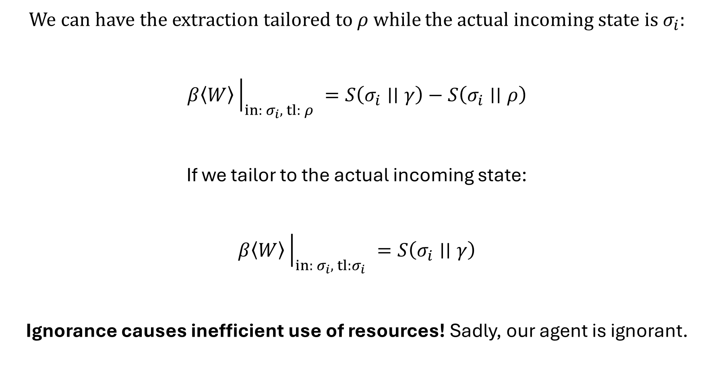
We can have the extraction tailored to $ρ$ while the actual incoming state is $σ_{i}$:
$$β\left\langle W\right\rangle {\left.​\right|}_{in: σ_{i}, tl: ρ} =S\left(σ_{i}∣∣γ\right)−S\left(σ_{i}∣∣ρ\right)$$
If we tailor to the actual incoming state:
$$β\left\langle W\right\rangle {\left.​\right|}_{in: σ_{i}, tl:σ_{i}} =S\left(σ_{i}∣∣γ\right)$$
Ignorance causes inefficient use of resources! Sadly, our agent is ignorant.
Riechers, P. M., & Gu, M. (2021). Physical Review E, 103(4), 042145.

Slide 29

We can have the extraction tailored to $ρ$:
$$β\left\langle W\right\rangle {\left.​\right|}_{in: σ_{i}, tl: ρ} =S\left(σ_{i}∣∣γ\right)−S\left(σ_{i}∣∣ρ\right)$$
Expectation of expected work:
$$β\left\langle W\right\rangle {\left.​\right|}_{tl: ρ} =\sum_{i=0}^{n−1}{p_{i}}\left(β\left\langle W\right\rangle {\left.​\right|}_{in: σ_{i}, tl: ρ}\right)$$
$$β\left\langle W\right\rangle {\left.​\right|}_{tl: ρ} =S\left(ξ∣∣γ\right)−S\left(ξ∣∣ρ\right)$$
If we choose $ρ$ to be $ξ$, we get it maximized.
Huang, R. C., Riechers, P. M., Gu, M., & Narasimhachar, V. (2023). Quantum, 7, 1203.

Slide 30
Greed is good [1]
From [1]
This is better than extracting from marginal states.
[1] Huang, R. C., Riechers, P. M., Gu, M., & Narasimhachar, V. (2023). Quantum, 7, 1203.

Slide 31
Our Problem: Is the greedy algorithm optimal?

Slide 32









Current work: Naïve, but defining global optimisation
Policy: Assigns the optimal thermal operation to every possible past.
Notes:
Explain everything

Slide 33
Current work: Naïve, but defining global optimisation
Policy: Assigns the optimal thermal operation to every possible past.
Naturally defines the time-ordered free energy.
Causal constraint: can only make use of the past
Optimisation uses all possible pasts
This is optimal
Notes:
Explain everything

Slide 34
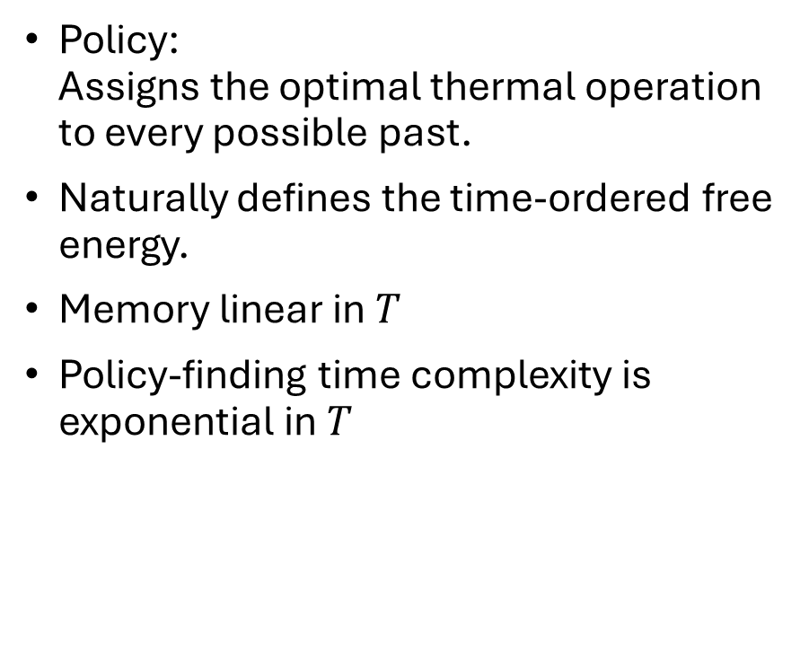
Current work: Naïve, but defining global optimisation
Policy: Assigns the optimal thermal operation to every possible past.
Naturally defines the time-ordered free energy.
Memory linear in $T$
Policy-finding time complexity is exponential in $T$
Notes:
Explain everything

Slide 35
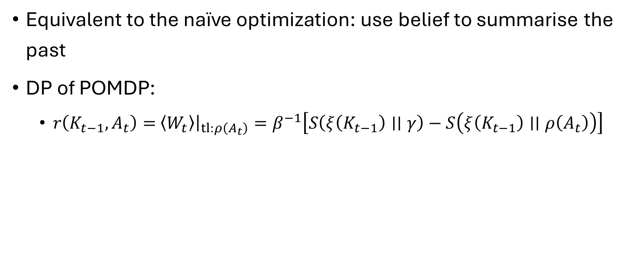
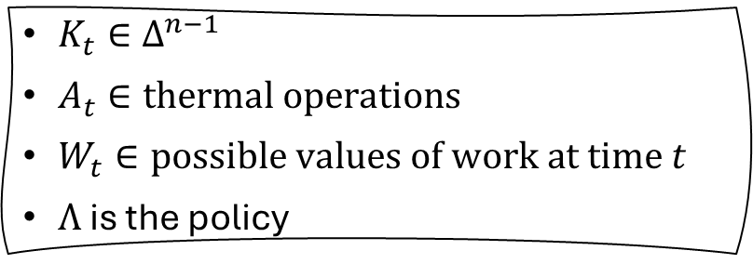
Dynamic Programming of Partially Observable Markov Decision Process
Equivalent to the naïve optimization: use belief to summarise the past
DP of POMDP:
$r\left(K_{t−1},A_{t}\right)=$ $\left\langle W_{t}\right\rangle {\left.​\right|}_{tl:ρ\left(A_{t}\right)}=β^{−1}\left[S\left(ξ\left(K_{t−1}\right)∣∣γ\right)−S\left(ξ\left(K_{t−1}\right)∣∣ρ\left(A_{t}\right)\right)\right]$
$K_{t}∈Δ^{n−1}$
$A_{t}∈thermal operations$
$W_{t}∈possible values of work at time t$
$Λ$ is the policy
Notes:
Explain that it is the same expression as the greedy

Slide 36
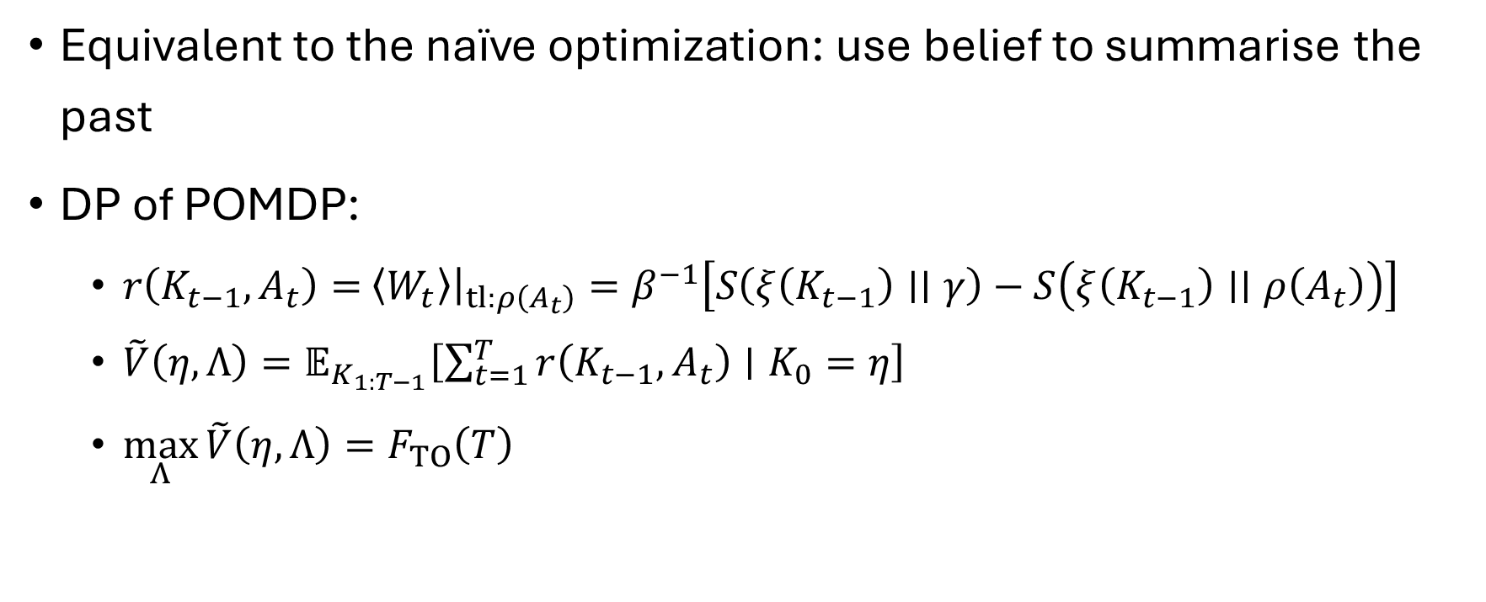
Dynamic Programming of Partially Observable Markov Decision Process
Equivalent to the naïve optimization: use belief to summarise the past
DP of POMDP:
$r\left(K_{t−1},A_{t}\right)=$ $\left\langle W_{t}\right\rangle {\left.​\right|}_{tl:ρ\left(A_{t}\right)}=β^{−1}\left[S\left(ξ\left(K_{t−1}\right)∣∣γ\right)−S\left(ξ\left(K_{t−1}\right)∣∣ρ\left(A_{t}\right)\right)\right]$
$\tilde{V}\left(η, Λ\right)=𝔼_{K_{1:T−1}}\left[\sum_{t=1}^{T}{r\left(K_{t−1},A_{t}\right)∣K_{0}=η}\right]$
$\max_{Λ}{\tilde{V}\left(η, Λ\right)}=F_{TO}\left(T\right)$
$K_{t}∈Δ^{n−1}$
$A_{t}∈thermal operations$
$W_{t}∈possible values of work at time t$
$Λ$ is the policy
Notes:
Explain that it is the same expression as the greedy

Slide 37
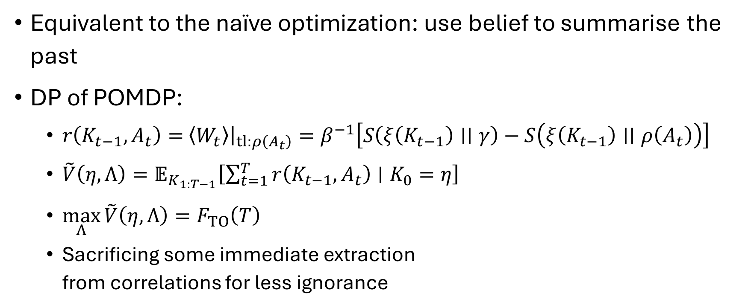
Dynamic Programming of Partially Observable Markov Decision Process
Equivalent to the naïve optimization: use belief to summarise the past
DP of POMDP:
$r\left(K_{t−1},A_{t}\right)=$ $\left\langle W_{t}\right\rangle {\left.​\right|}_{tl:ρ\left(A_{t}\right)}=β^{−1}\left[S\left(ξ\left(K_{t−1}\right)∣∣γ\right)−S\left(ξ\left(K_{t−1}\right)∣∣ρ\left(A_{t}\right)\right)\right]$
$\tilde{V}\left(η, Λ\right)=𝔼_{K_{1:T−1}}\left[\sum_{t=1}^{T}{r\left(K_{t−1},A_{t}\right)∣K_{0}=η}\right]$
$\max_{Λ}{\tilde{V}\left(η, Λ\right)}=F_{TO}\left(T\right)$
Sacrificing some immediate extraction from correlations for less ignorance
$K_{t}∈Δ^{n−1}$
$A_{t}∈thermal operations$
$W_{t}∈possible values of work at time t$
$Λ$ is the policy
Notes:
Explain that it is the same expression as the greedy

Slide 38
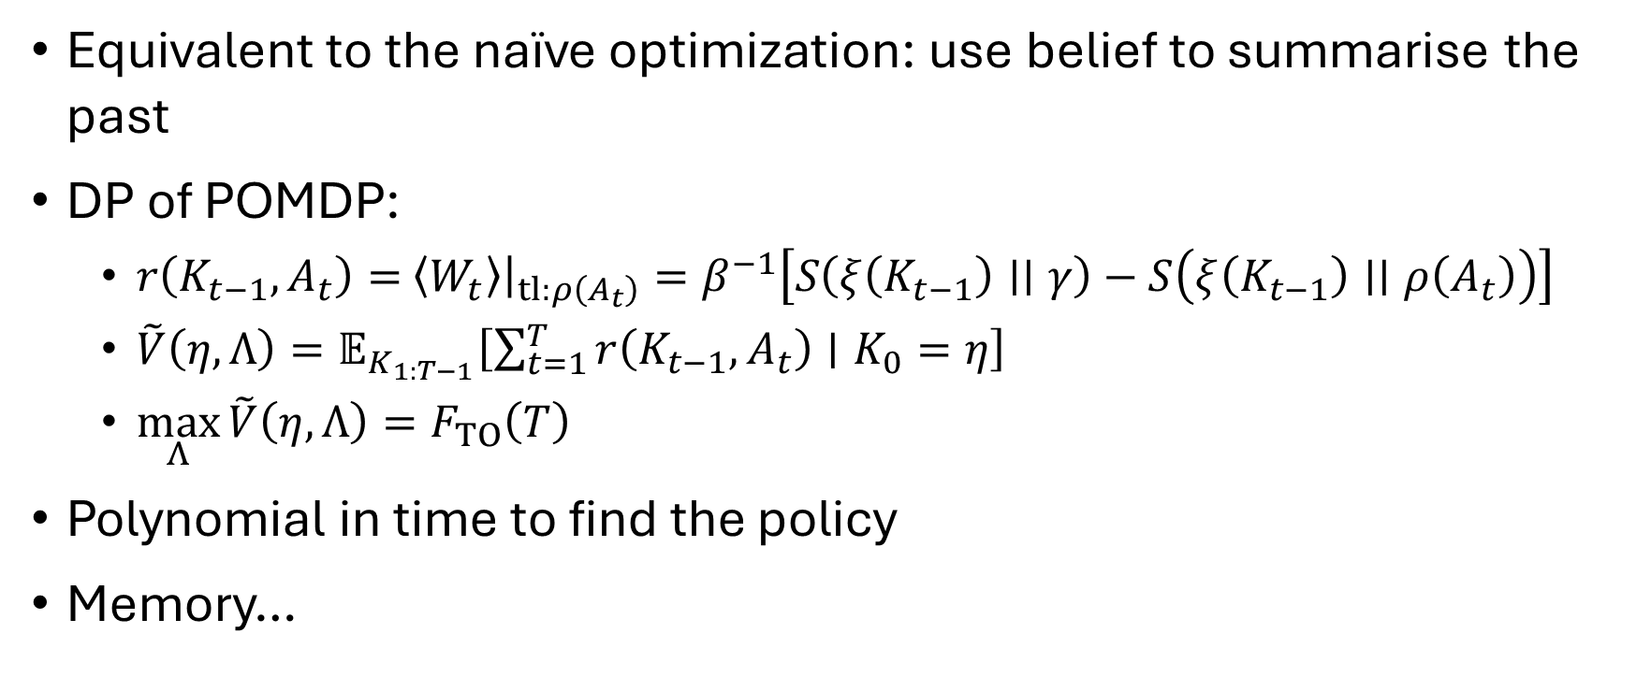
Dynamic Programming of Partially Observable Markov Decision Process
Equivalent to the naïve optimization: use belief to summarise the past
DP of POMDP:
$r\left(K_{t−1},A_{t}\right)=$ $\left\langle W_{t}\right\rangle {\left.​\right|}_{tl:ρ\left(A_{t}\right)}=β^{−1}\left[S\left(ξ\left(K_{t−1}\right)∣∣γ\right)−S\left(ξ\left(K_{t−1}\right)∣∣ρ\left(A_{t}\right)\right)\right]$
$\tilde{V}\left(η, Λ\right)=𝔼_{K_{1:T−1}}\left[\sum_{t=1}^{T}{r\left(K_{t−1},A_{t}\right)∣K_{0}=η}\right]$
$\max_{Λ}{\tilde{V}\left(η, Λ\right)}=F_{TO}\left(T\right)$
Polynomial in time to find the policy
Memory…
$K_{t}∈Δ^{n−1}$
$A_{t}∈thermal operations$
$W_{t}∈possible values of work at time t$
$Λ$ is the policy
Notes:
Explain that it is the same expression as the greedy

Slide 39
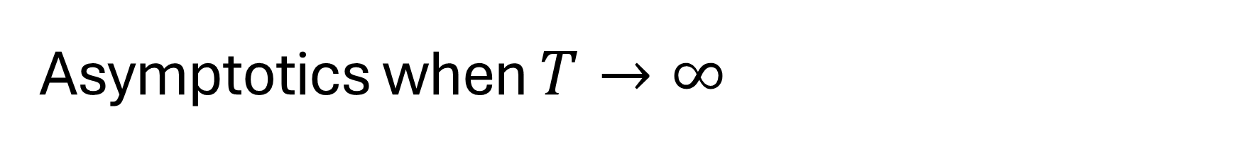
Asymptotics when $T→∞$
Good behaviour
A transient regime in belief dynamics due to edge effects disappears
Only steady state regime remains. It has is a set of recurrent beliefs.
Memory size constant in time!
Notes:
Explain that the plots are examples for the perturbed coin

Slide 40
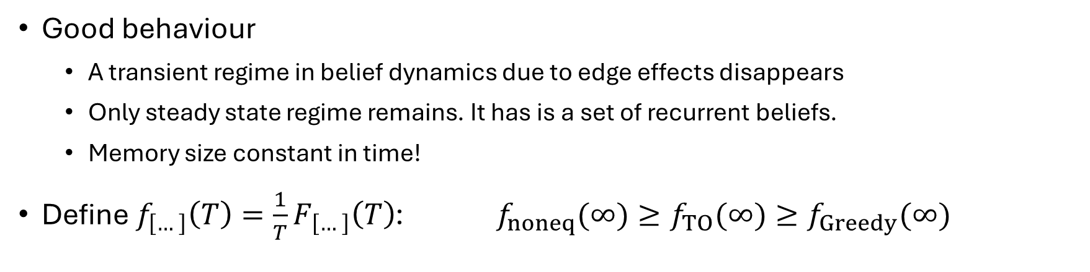
Asymptotics when $T→∞$
Good behaviour
A transient regime in belief dynamics due to edge effects disappears
Only steady state regime remains. It has is a set of recurrent beliefs.
Memory size constant in time!
Define $f_{\left[…\right]}\left(T\right)=\frac{1}{T}F_{\left[…\right]}\left(T\right)$: $f_{noneq}(∞)≥f_{TO}(∞)≥f_{Greedy}(∞)$
Notes:
Explain that the plots are examples for the perturbed coin

Slide 41
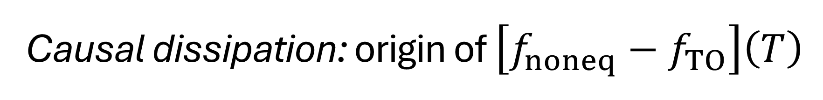
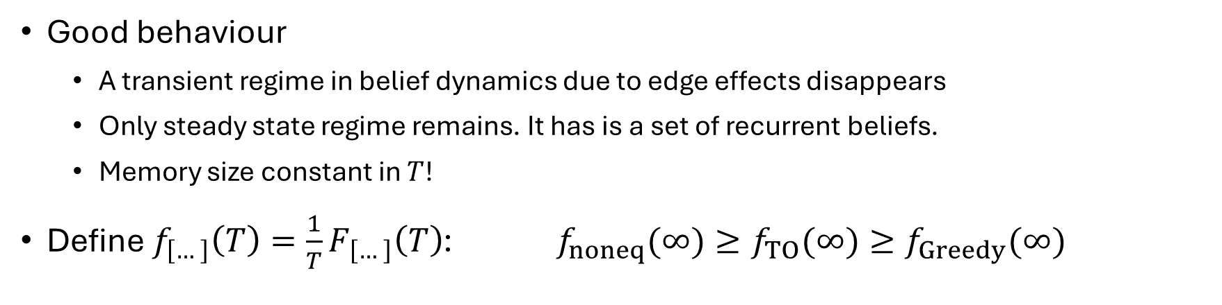
Asymptotics when $T→∞$
Good behaviour
A transient regime in belief dynamics due to edge effects disappears
Only steady state regime remains. It has is a set of recurrent beliefs.
Memory size constant in $T$!
Define $f_{\left[…\right]}\left(T\right)=\frac{1}{T}F_{\left[…\right]}\left(T\right)$: $f_{noneq}(∞)≥f_{TO}(∞)≥f_{Greedy}(∞)$
Causal dissipation: origin of $\left[f_{noneq}−f_{TO}\right]\left(T\right)$
It is a multipartite generalisation of thermal discord (Zurek, 2003)
Notes:
Explain that the plots are examples for the perturbed coin

Slide 42
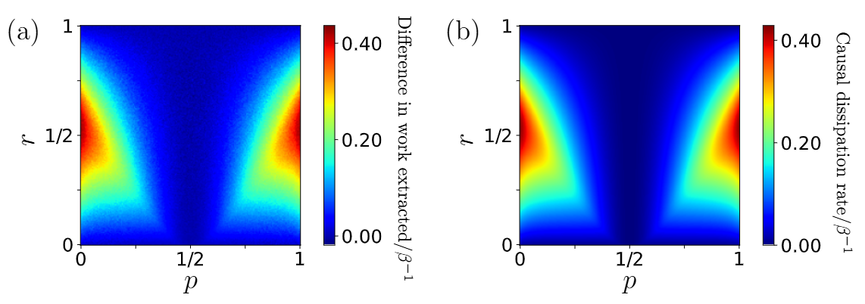

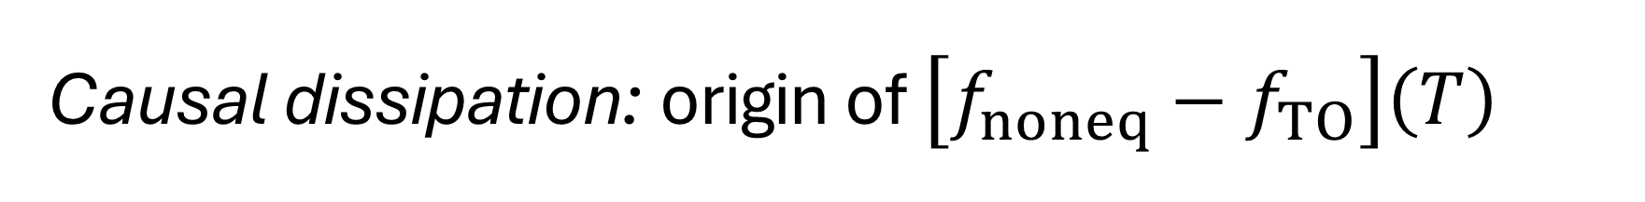
Causal dissipation: origin of $\left[f_{noneq}−f_{TO}\right]\left(T\right)$
It is a multipartite generalisation of thermal discord (Zurek, 2003)
Example: $T=3$

Slide 43
Results
Efficient way to find and extract TOFE, the free energy under causal constraints
Greedy is NOT optimal
Causal dissipation is a generalisation of thermal discord

Slide 44
Outlook
Resource theory of temporal quantum correlations
Agentic learning/extraction of quantum systems/resources for other quantum information processing tasks

