Slide 1
No Universal Purification in Quantum Mechanics
Zhenhuan Liu, Zhenyu Du, Zhenyu Cai, Jens Eisert, Zi-Wen Liu
qubithuan@gmail.com
arXiv:2509.21111
Notes:
Hello, everyone. I am Zhenhuan Liu and this is already my second time to give a talk in TII.
I am very happy to have the chance to introduce our recent work.
The title of the paper is “No Universal Purification in Quantum Mechanics”.
This is the arxiv number of it.
I am now waiting for the VISA, so I do not have affiliation.

Slide 2
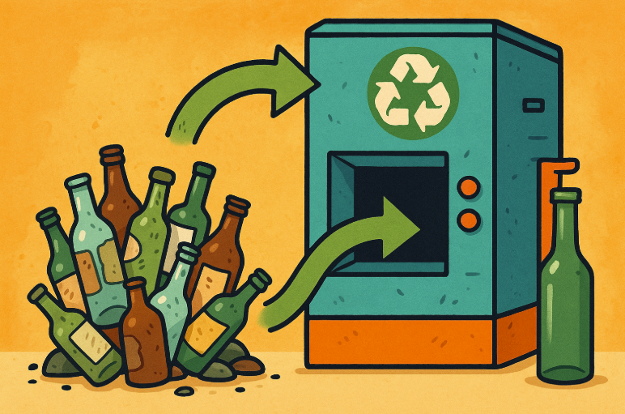


Purification
In quantum information processing tasks, some objectives (states or channels) are more valuable than others.
We need to concentrate the resource from more copies to less copies.
$$ℳ$$
$$ρ^{⊗t} σ$$
Notes:
So, this work is about quantum purification.
Purification is like resource recycling. In our daily life, we sometimes need to gather some old staffs to get a new one.
We also need to recycle resources in quantum world.
This is because we know that, in quantum information processing tasks, some states or channels are more valuable than others.
Such as the Bell state in quantum communication, noiseless quantum gate in quantum computation.
So we need to concentrate the resource from more copies states to less copies.

Slide 3
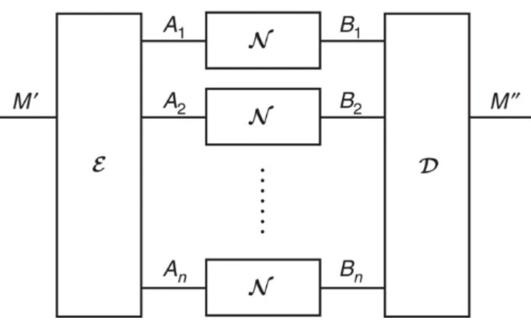
With fixed output
Entanglement Distillation
Magic Distillation
Channel Coding[1]
Their limitations are analyzed under the restriction of free operations[2].
[1] Tomamichel, Marco, Mario Berta, and Joseph M. Renes. Nature communications 7.1 (2016): 11419.
[2] Fang K, Liu Z W. Physical Review Letters, 2020, 125(6): 060405.
Notes:
Because purification is very important in quantum information processing, people have developed many different protocols.
We can roughly classify them into two types.
The first type is those with fixed output.
For example, in entanglement distillation, our target is to produce Bell pairs.
In magic distillation, the target is T state.
And in channel coding, the target is the noiseless identity channel.
If we don’t have any restrictions, these tasks are easy. Because you can just prepare a channel that outputs these target states.
But normally, when we are considering these tasks, our allowed operations are restricted.
For example, entanglement distillation is required when we are doing quantum communication. So only LOCC are allowed.
And magic distillation is required in some stabilizer codes, in which only Clifford operations are cheap.
It is already clear that, fundamental limitations exist in these tasks given the restricted operations.

Slide 4
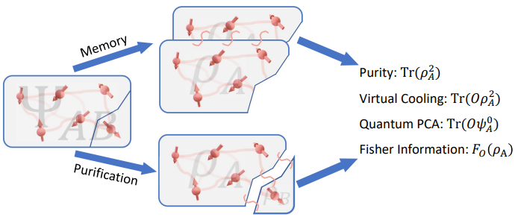
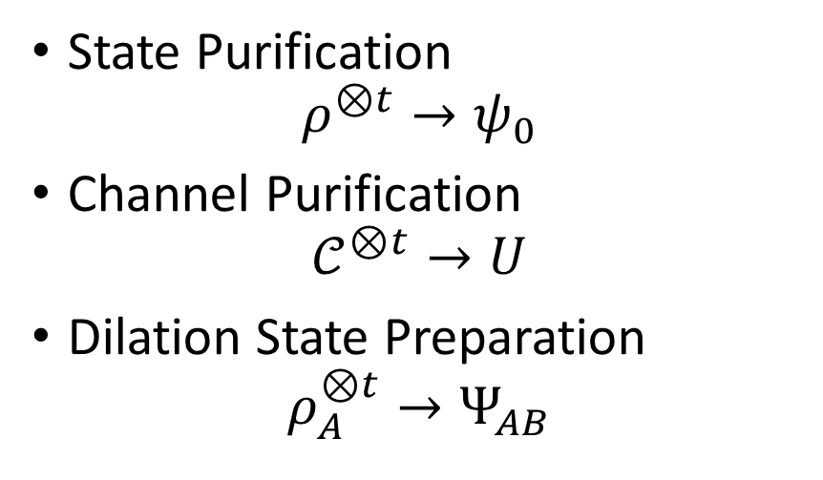
Without fixed output
State Purification
$$ρ^{⊗t}→ψ_{0}$$
Channel Purification
$$𝒞^{⊗t}→U$$
Dilation State Preparation
$$ρ_{A}^{⊗t}→Ψ_{AB}$$
What is the limitation for these tasks without restrictions on free operations?
Cotler J, Choi S, Lukin A, et al. Physical Review X, 2019, 9(3): 031013.
Liu Z, Zhang X, Fei Y Y, et al. PRX Quantum, 2025, 6(2): 020325.
Liu Z, Gong W, Du Z, et al. arXiv preprint arXiv:2410.17718, 2024.
Notes:
Another type of quantum purification tasks are those without fixed output.
For example, xxxx.
Different with the first type, we normally do not have any restrictions when considering these tasks.
But until now, no one ever developed a protocol that can achieve these tasks perfectly.
All protocols we have can only approximately realize these tasks, with certain sample complexity.
So, in this work, we want to ask, what is the fundamental limitation for these tasks even without any restrictions on operations.

Slide 5
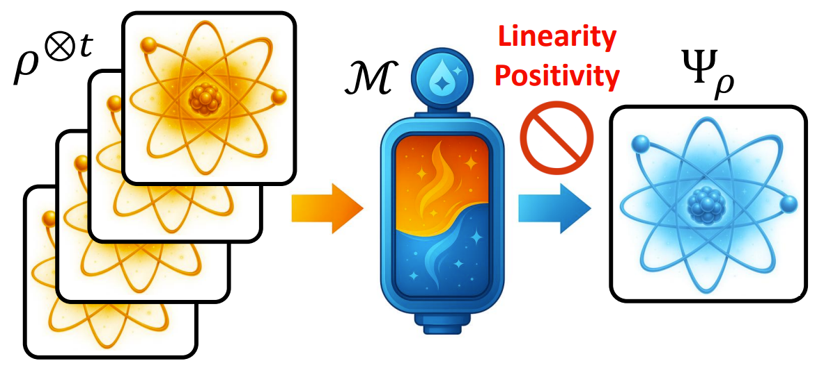
No Purification Theorem
Linearity and Positivity of quantum mechanics prevent input-dependent purification.
Notes:
In this work, we uncover that, the linearity and positivity of quantum mechanics prevent the universal quantum purification.
Specifically, it is not possible to design a quantum operation, that takes a finite copy of rho as the input, and outputs a pure state which depends on the input state.

Slide 6
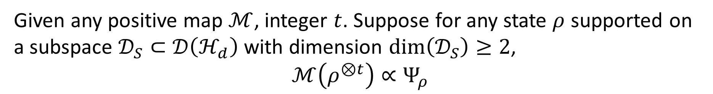
No Purification Theorem
Given any positive map $ℳ$, integer $t$. Suppose for any state $ρ$ supported on a subspace $𝒟_{S}⊂𝒟\left(ℋ_{d}\right)$ with dimension $dim\left(𝒟_{S}\right)≥2$,
$$ℳ\left(ρ^{⊗t}\right)∝Ψ_{ρ}$$
Then we have
$$ℳ\left(ρ^{⊗t}\right)∝Ψ$$
With finite input copies, it is impossible to produce an input-dependent output pure state.
Notes:
Our first results is the following theorem, which we call no purification theorem.

Slide 7



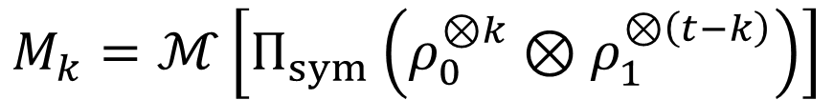

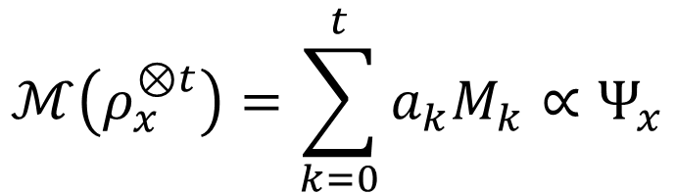
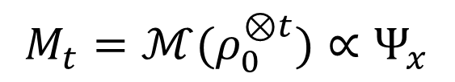
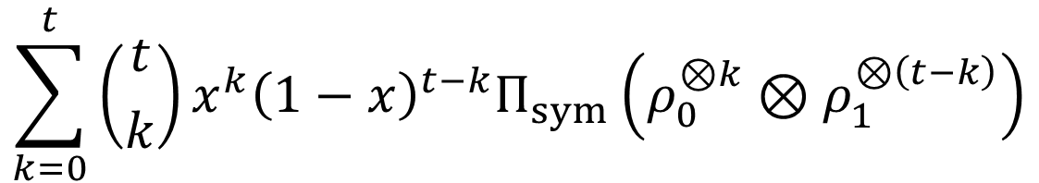


Proof
$$ℳ\left(ρ_{x}^{⊗t}\right)=\sum_{k=0}^{t}{a_{k}M_{k}}∝Ψ_{x}$$
$$ρ_{x}=xρ_{0}+\left(1−x\right)ρ_{1}$$
$$a_{k}≥0 M_{k}≥0$$
$$ℳ\left(ρ_{x}^{⊗t}\right)=ℳ\left[{\left(xρ_{0}+\left(1−x\right)ρ_{1}\right)}^{⊗t}\right]∝Ψ_{x}$$
Positivity
Linearity
$$\sum_{k=0}^{t}{\left({t \atop k}\right)x^{k}{\left(1−x\right)}^{t−k}Π_{sym}\left(ρ_{0}^{⊗k}⊗ρ_{1}^{⊗\left(t−k\right)}\right)}$$
$$M_{k}∝Ψ_{x}$$
$$M_{0}=ℳ(ρ_{1}^{⊗t})∝Ψ_{x}$$
$$a_{k}=\left({t \atop k}\right)x^{k}{\left(1−x\right)}^{t−k}$$
$$M_{t}=ℳ(ρ_{0}^{⊗t})∝Ψ_{x}$$
$$M_{k}=ℳ\left[Π_{sym}\left(ρ_{0}^{⊗k}⊗ρ_{1}^{⊗\left(t−k\right)}\right)\right]$$
$$ℳ(ρ^{⊗t})∝Ψ$$
Notes:
The proof is very simple, please follow me.
I promise this is the only page in this talk you need to use your brain.
So, from this proof, you can notice that the only properties we use of quantum mechanics is the linearity and positivity.

Slide 8
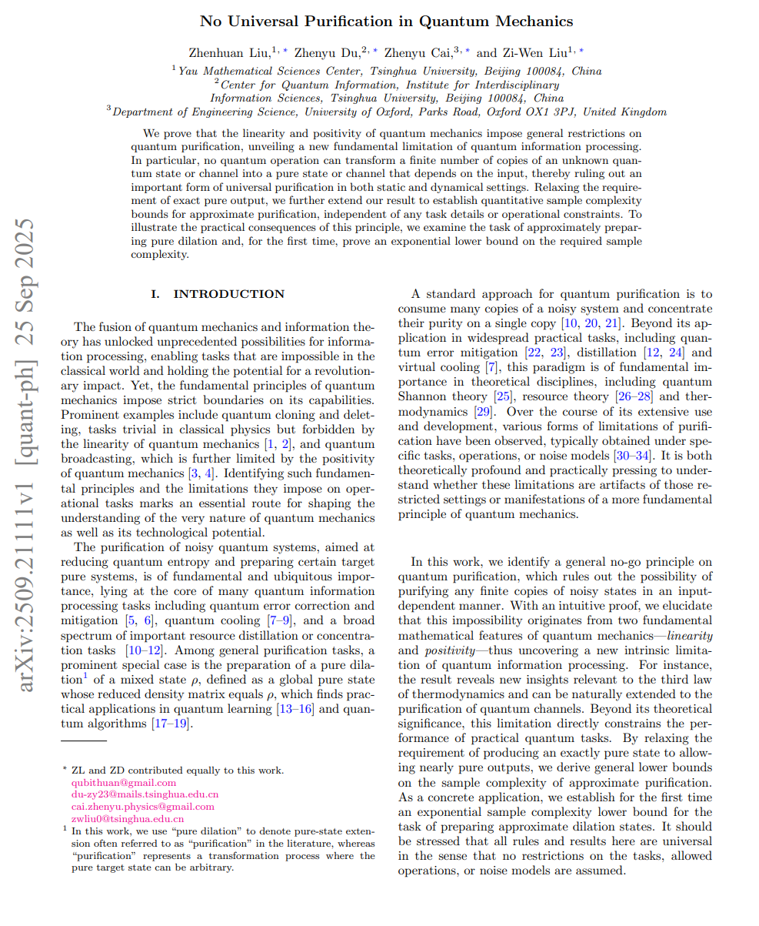
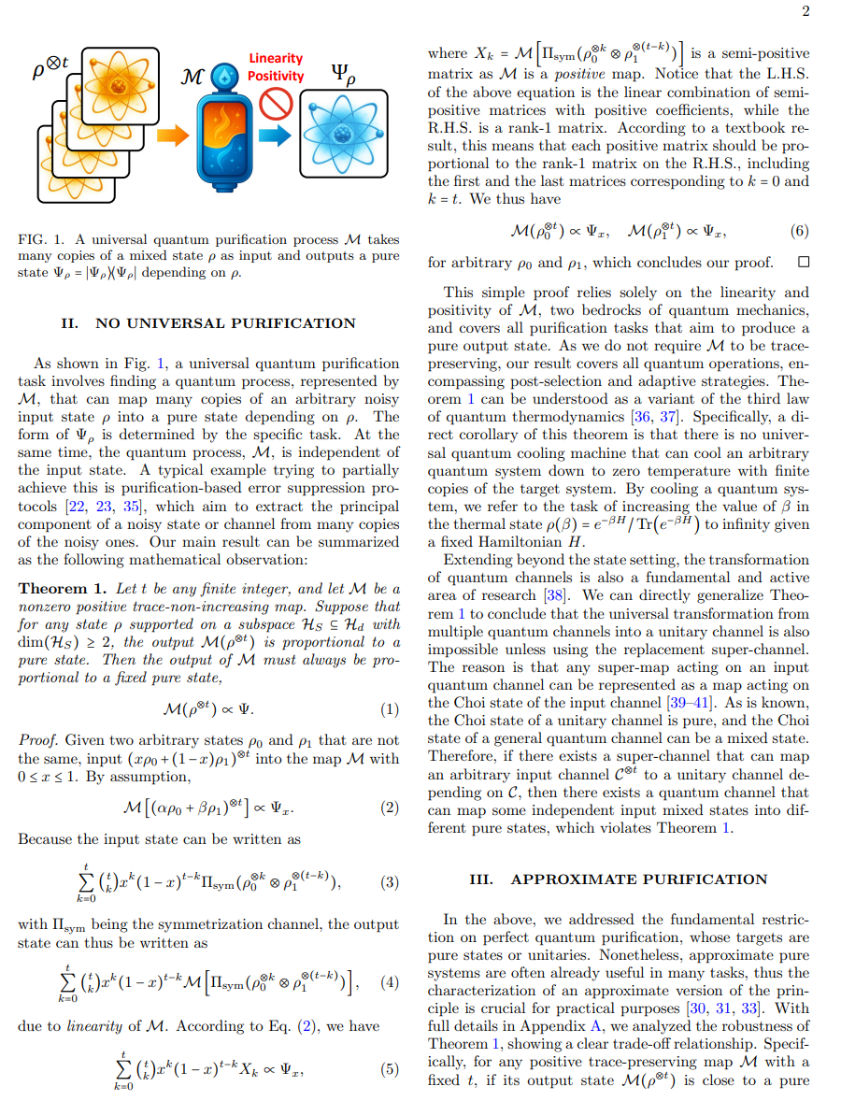
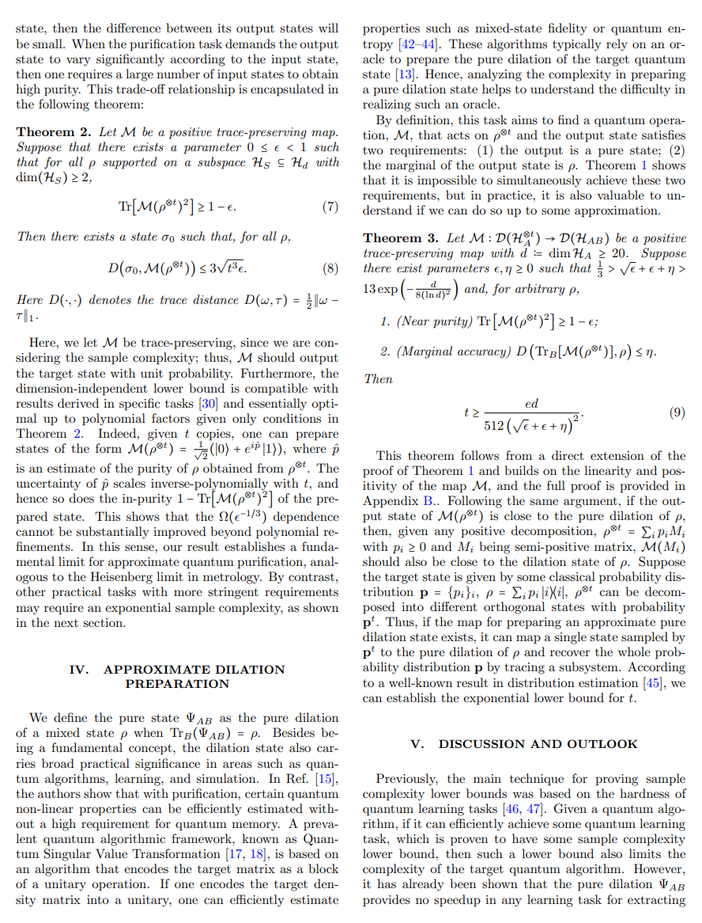
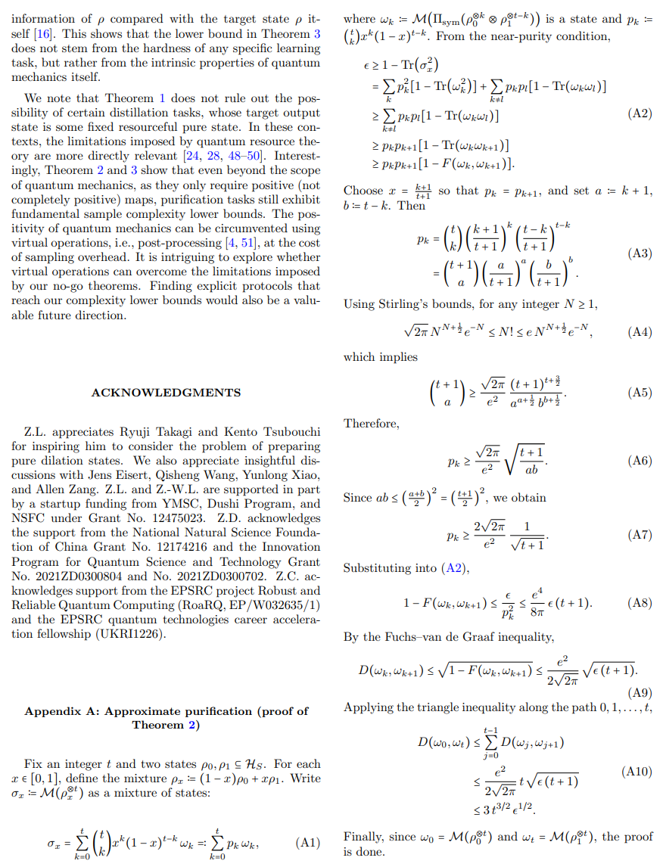
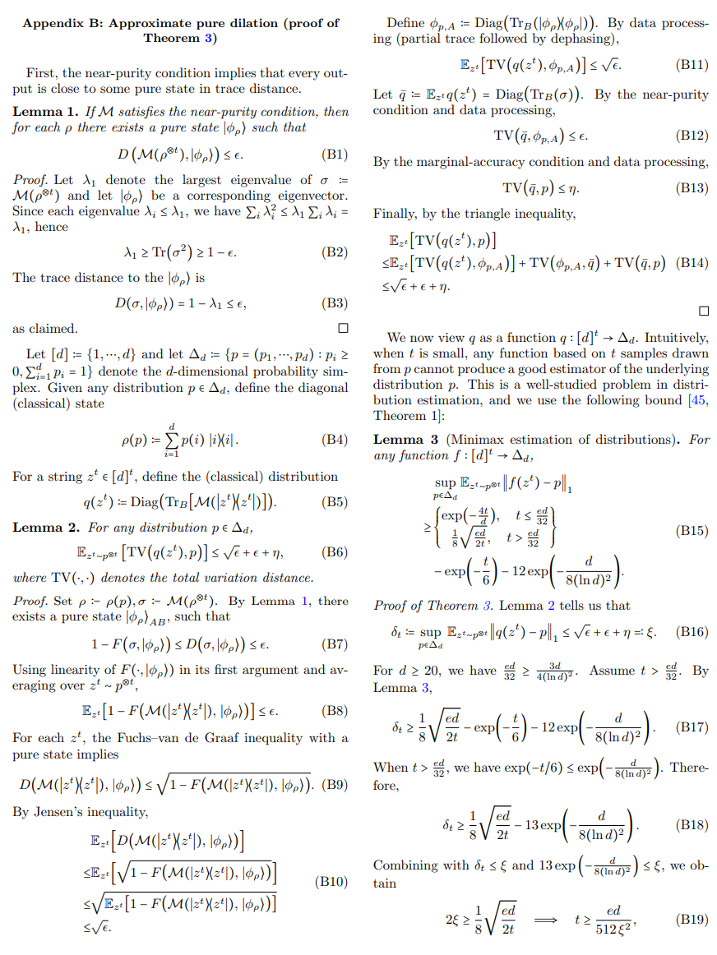
Notes:
I highly suggest you to read our manuscript.
We try to make it easily readable.
It is really short.
The main text has only three pages. And the appendix has only two pages.

Slide 9
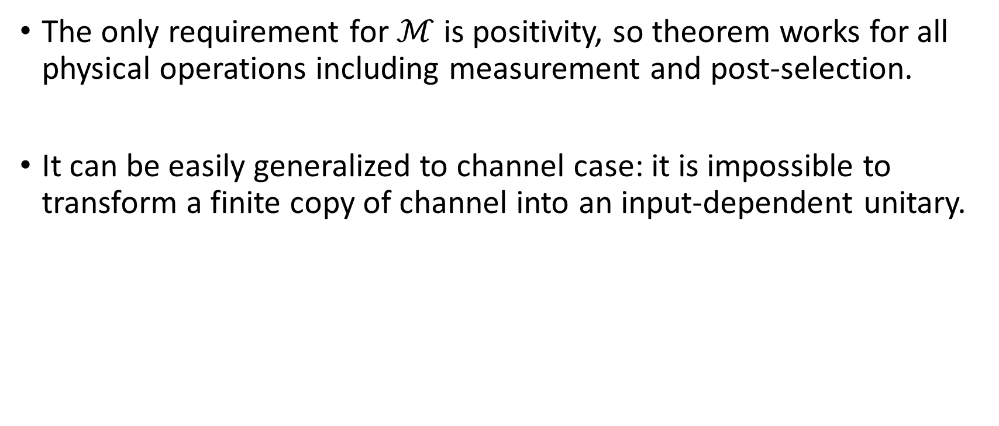
Remarks
The only requirement for $ℳ$ is positivity, so theorem works for all physical operations including measurement and post-selection.
It can be easily generalized to channel case: it is impossible to transform a finite copy of channel into an input-dependent unitary.

Slide 10
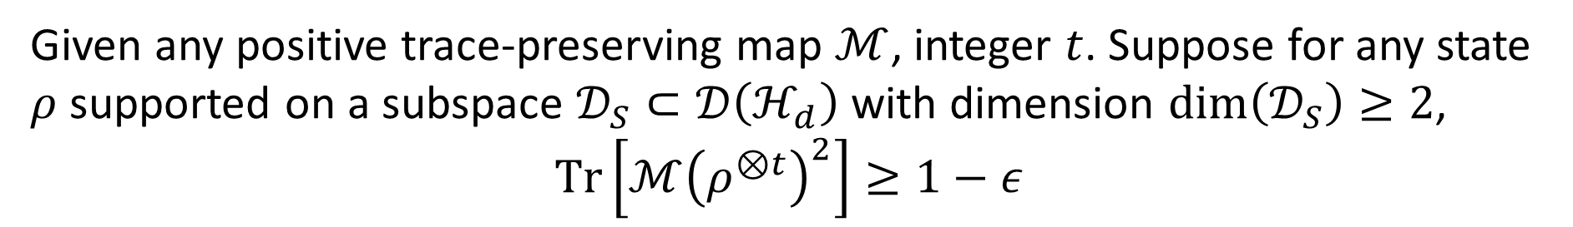

Approximate Purification Theorem
Given any positive trace-preserving map $ℳ$, integer $t$. Suppose for any state $ρ$ supported on a subspace $𝒟_{S}⊂𝒟\left(ℋ_{d}\right)$ with dimension $dim\left(𝒟_{S}\right)≥2$,
$$Tr\left[ℳ{\left(ρ^{⊗t}\right)}^{2}\right]≥1−ε$$
Then there exists a state $σ_{0}$ such that for all $ρ$
$$D\left(σ_{0},ℳ\left(ρ^{⊗t}\right)\right)≤\left(8π\sqrt{2t}+12\right)\sqrt{ε}$$
Given a fixed sample complexity, there is a trade-off between the purity and difference of the output state.
Notes:
So we have proved that perfect purification is not possible.
But we acknowledge that in many practical tasks, we only need approximate purification.
So we generalize our no purification theorem to a approximate version.
We prove that, if you do not require the output state to be exactly pure, but close to a pure state.
like the purity to be larger than 1-epsilon.
Then there exists a state, such that for all rho, xxx
This means that, xxx
This is a pretty general theorem, and the sample complexity lower bound is dimension independent.
But we will show that, in some specific tasks, the sample complexity may have a much larger lower bound.

Slide 11

Approximate Purification Theorem
$$D\left(σ_{0},ℳ\left(ρ^{⊗t}\right)\right)≤\left(8π\sqrt{2t}+12\right)\sqrt{ε}$$
$$t=Ω\left(ε^{−1}\right)$$
Such a scaling appears universally in:
Quantum State Purification. [Quantum 9 (2025): 1603, arXiv:2409.18167]
Quantum Fisher Information. [Quantum 5 (2021): 521]
Quantum Error Correction. [PhysRevX.10.041018]
Notes:
While, lets take a second look at the equation in the last page.
According to this equation, if we want the output state to have large difference, then it gives a lower bound on the sample complexity.
This scaling appears universally in many different fields: xxx xxx xxx
I believe that our result gives a fundamental reason for them.
Besides, this lower bound is dimension-independent.
But for some specific purification task, we can have a much larger sample complexity.

Slide 12
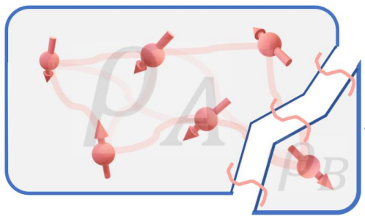
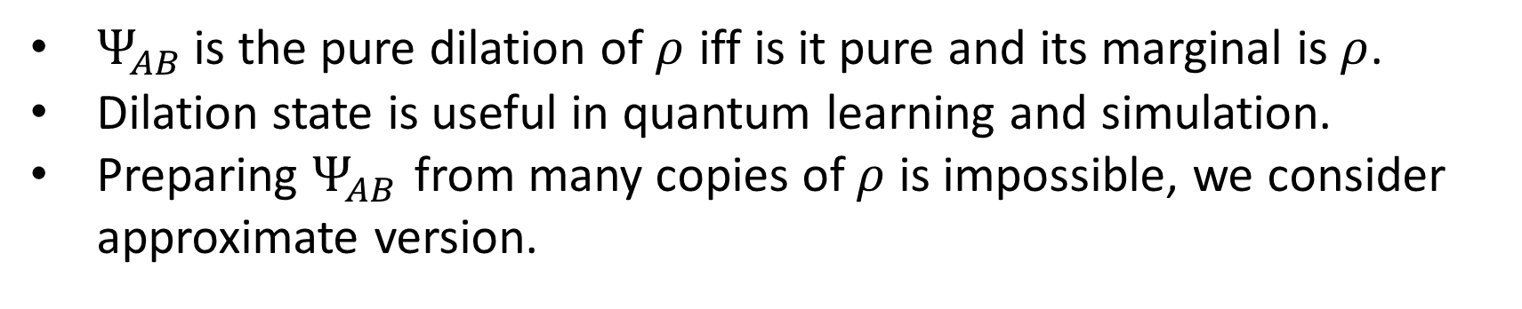
Dilation State Preparation
$Ψ_{AB}$ is the pure dilation of $ρ$ iff is it pure and its marginal is $ρ$.
Dilation state is useful in quantum learning and simulation.
Preparing $Ψ_{AB}$ from many copies of $ρ$ is impossible, we consider approximate version.
Liu Z, Gong W, Du Z, et al. arXiv preprint arXiv:2410.17718, 2024.
Gilyén A, Li T. arXiv preprint arXiv:1902.00814, 2019.
Notes:
In the last part of this work, we talk about the task of preparing the dilation state.

Slide 13
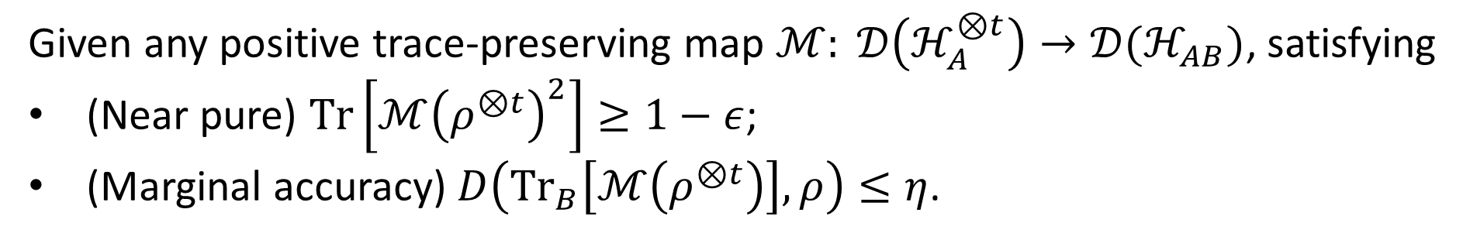

Dilation State Preparation
Given any positive trace-preserving map $ℳ: 𝒟\left(ℋ_{A}^{⊗t}\right)→𝒟(ℋ_{AB})$, satisfying
(Near pure) $Tr\left[ℳ{\left(ρ^{⊗t}\right)}^{2}\right]≥1−ε$;
(Marginal accuracy) $D\left({Tr}_{B}\left[ℳ\left(ρ^{⊗t}\right)\right],ρ\right)≤η$.
Then we have
$$t≥\frac{ed}{512{\left(\sqrt{ε}+ε+η\right)}^{2}}$$
Notes:
So, we relax the two requirements of dilation state.
Although I do not want to introduce the proof of this theorem, I would like to point out that, the proof of this theorem, together with the last theorem, they are both highly related with the proof of the first no purification theorem, the perfect one.

Slide 14
Take-home messages
Fundamental limitations exist in quantum purification tasks.
It is impossible (difficult) to output input-dependent (approximate) pure state.
Can we build a general resource theory of quantum mechanics.

Slide 15
Thanks!

