Slide 1

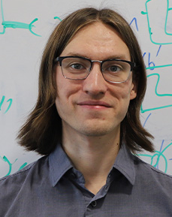
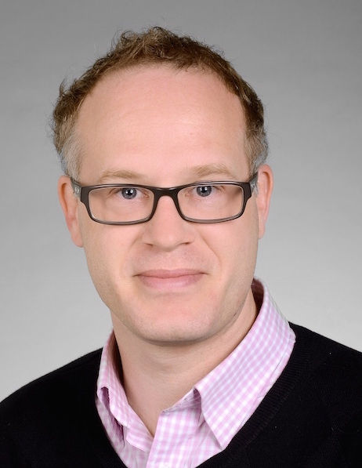
Understanding “Fully Quantum” Correlations via Non-Commutative Probability Theory
arXiv: 2505.15281 (to be updated soon)
Marco Tomamichel
Ian George

Slide 2
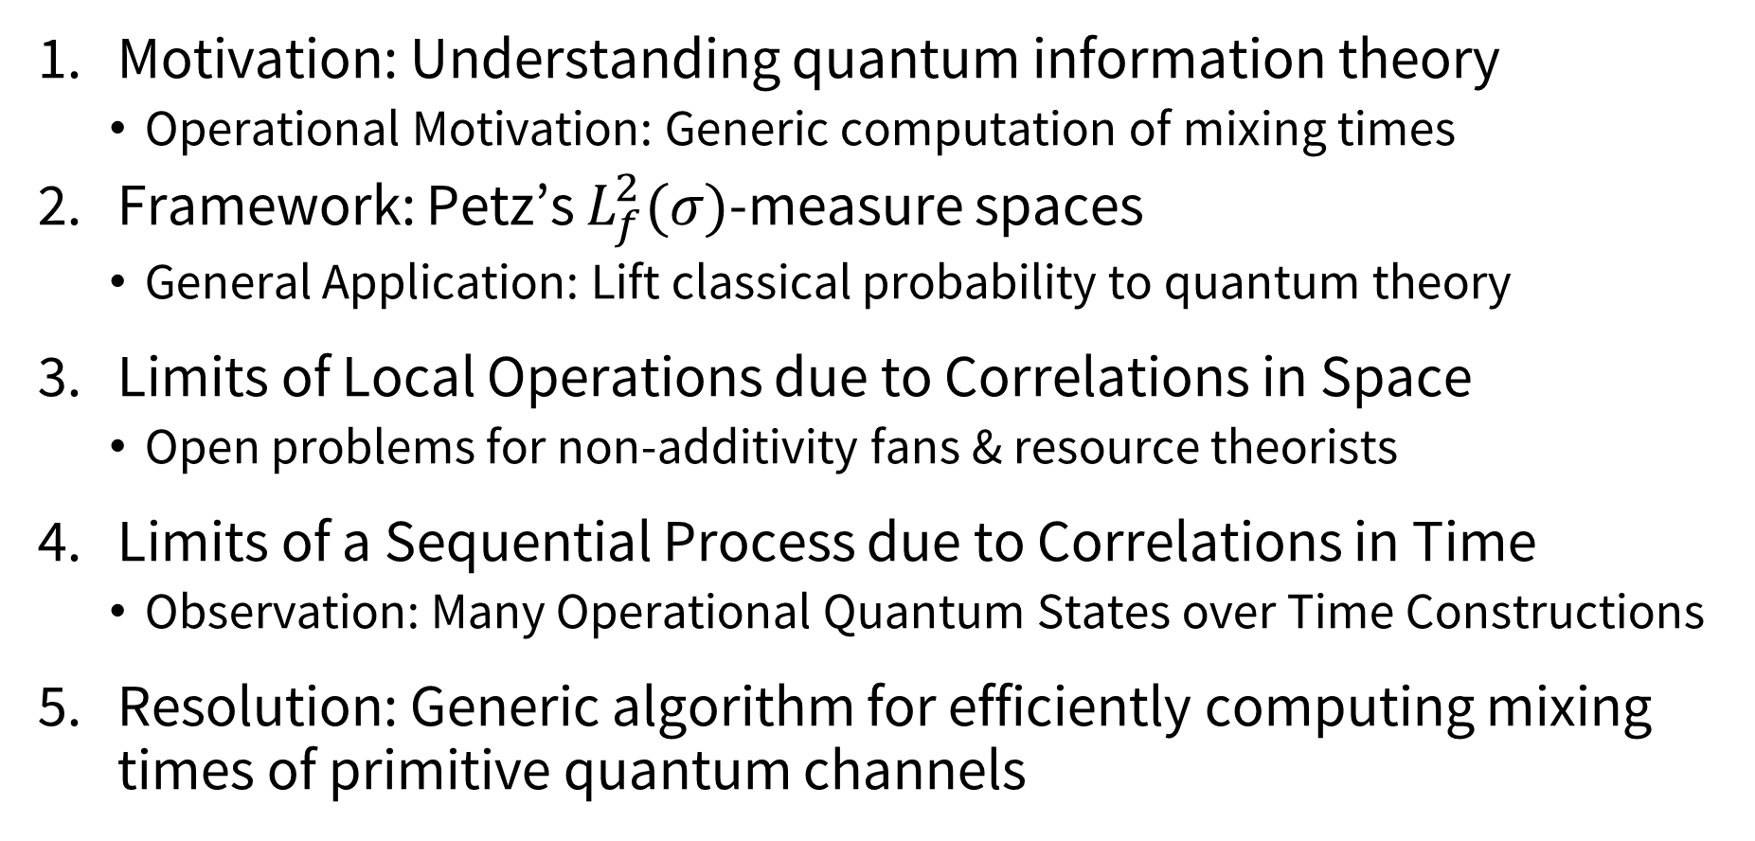
Outline
Motivation: Understanding quantum information theory
  Operational Motivation: Generic computation of mixing times
Framework: Petz’s $L_{f}^{2}(σ)$-measure spaces
  General Application: Lift classical probability to quantum theory
Limits of Local Operations due to Correlations in Space
  Open problems for non-additivity fans & resource theorists
Limits of a Sequential Process due to Correlations in Time
  Observation: Many Operational Quantum States over Time Constructions
Resolution: Generic algorithm for efficiently computing mixing times of primitive quantum channels

Slide 3


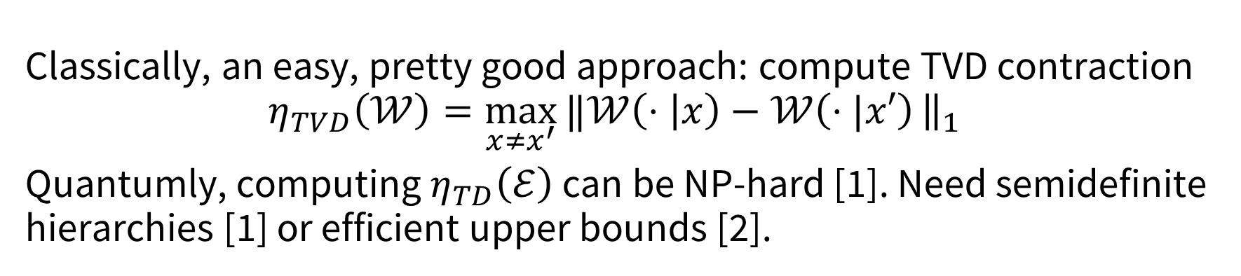


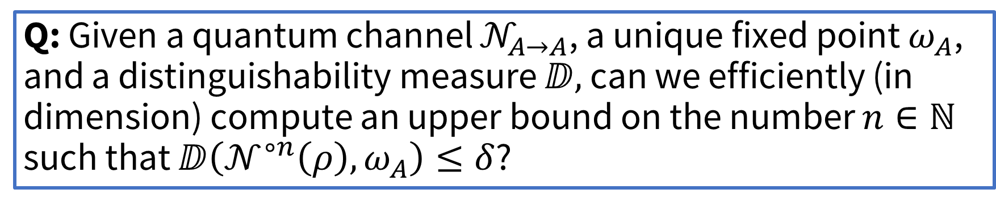




Operational Motivation
$$𝒩$$
$$𝒩$$
$$…$$
$$𝒩$$
$$ρ$$
$${≈_{δ}ω}_{A}$$
$$?$$
$$𝒩^{n}$$
Q: Given a quantum channel $𝒩_{A→A}$, a unique fixed point $ω_{A}$, and a distinguishability measure ⅅ, can we efficiently (in dimension) compute an upper bound on the number $n∈ℕ$ such that ⅅ$\left(𝒩^{∘n}\left(ρ\right),ω_{A}\right)≤δ$?
Classically, an easy, pretty good approach: compute TVD contraction
$$η_{TVD}\left(𝒲\right)=\max_{x≠x^{′}}{‖𝒲\left(⋅ | x\right)−𝒲\left(⋅|x′\right)}{\left.​\right\|}_{1}$$
Quantumly, computing $η_{TD}\left(ℰ\right)$ can be NP-hard [1]. Need semidefinite hierarchies [1] or efficient upper bounds [2].
[1] Delsol et al. “Computational aspects of the trace norm contraction coefficient,” 2025.
[2] IG, Hirche, Nuradha, Wilde. “Quantum Doeblin Coefficients: Interpretations and Applications,” 2025.

Slide 4
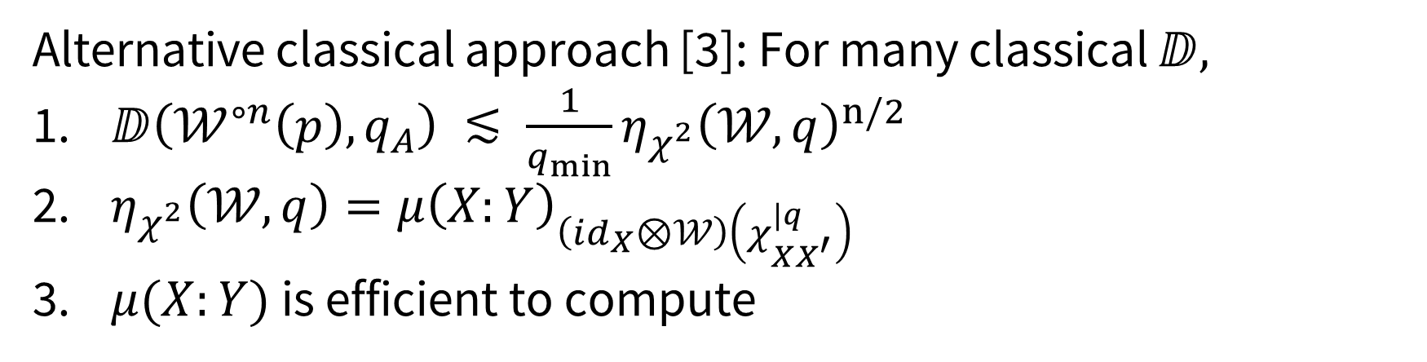
Operational Motivation
$$𝒩$$
$$𝒩$$
$$…$$
$$𝒩$$
$$ρ$$
$${≈_{δ}ω}_{A}$$
$$?$$
$$𝒩^{n}$$
Alternative classical approach [3]: For many classical ⅅ,
$\text{ⅅ}\left(𝒲^{∘n}\left(p\right),q_{A}\right) ≲ \frac{1}{q_{min}}η_{χ^{2}}{\left(𝒲,q\right)}^{n/2}$
$η_{χ^{2}}\left(𝒲,q\right)=μ{\left(X:Y\right)}_{\left(id_{X}⊗𝒲\right)\left(χ_{XX^{′}}^{|q}\right)}$
$μ(X:Y)$ is efficient to compute
Q: Can this be lifted to the quantum setting?
[3] IG, Zheng, Bansal. “Divergence Inequalities with Applications in Ergodic Theory,” 2024.

Slide 5
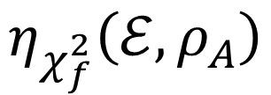

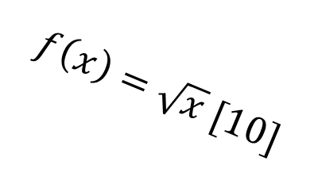



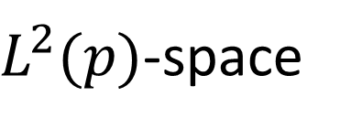

Classical Information Theory
Quantum Information Theory
$L^{2}(p)$-space
$$μ_{\sqrt{⋅}}\left(ρ_{AB}\right)$$
[4]
[7]
$$f\left(x\right)=\sqrt{x} [10]$$
$$≠$$
$$η_{χ_{f}^{2}}\left(ℰ,ρ_{A}\right)$$
$$μ\left(p_{XY}\right)$$
$$η_{χ^{2}}(𝒲,q)$$
$$μ_{B}\left(ρ_{AB}\right)$$
[7]
[4]
[5,6]
[8]
[9]
Limits in Information Processing under LO
Bounds Convergence to Fixed Point
Some Limits in Information Processing under LO
Bounds Convergence to Fixed Point
[4] Witsenhausen. “On Sequences of Pairs of Dependent Random Variables,” 1975.
[5] Diaconis & Stroock. “Geometric Bounds for Eigenvalues of Markov Chains,” 1991.
[6] Fill. “Eigenvalue Bounds on Convergence to Stationarity for Non-Reversible Markov Chains,” 1991.
[7] Raginsky. “Strong Data Processing Inequalities and $Φ$-Sobolev Inequalities for Discrete Channels,” 2016.
[8] Beigi. “A New Quantum Data Processing Inequality” 2013.
[9] Temme et al. “The $χ^{2}$-divergence and mixing times of quantum Markov processes,” 2010.
[10] Cao & Lu. “Tensorization of the strong data processing inequality for quantum chi-square divergences,” 2019.

Slide 6


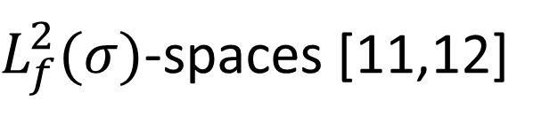

Classical Information Theory
Quantum Information Theory
$L^{2}(p)$-space
$L_{f}^{2}(σ)$-spaces [11,12]
Efficient to
Compute
$$μ_{f}\left(ρ_{AB}\right)$$
$$η_{χ_{f}^{2}}\left(ℰ,ρ_{A}\right)$$
$$μ\left(p_{XY}\right)$$
$$η_{χ^{2}}(𝒲,q)$$
[2]
Limits in Information Processing under LO
Limits in Sequential Information Processing
Limits in Sequential Information Processing
Limits in Information Processing under LO (up to non-additivity
question)
Efficient Mixing Times
[11] Petz. “Monotone Metrics on Matrix Spaces,” 1996.
[12] Petz. “Covariance and Fisher Information in Quantum Mechanics,” 2002.

Slide 7
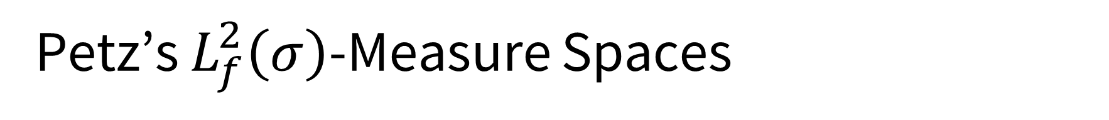
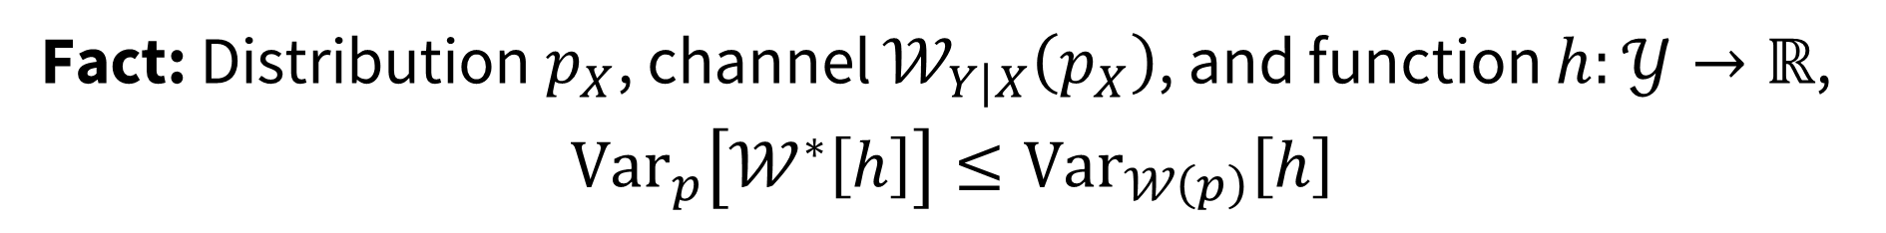
Petz’s $L_{f}^{2}\left(σ\right)$-Measure Spaces
Classically, ${\left\langle g,h\right\rangle }_{p}={\left\langle g,J_{p}\left(h\right)\right\rangle }_{Euc}$ where $J_{p}\left(h\right)=Σ_{i} p_{i}h_{i}$.
$𝔼_{p}\left[h\right]≔{\left\langle 1,h\right\rangle }_{p}$ $Var_{p}\left[h\right]≔{\left\langle h−𝔼_{p}\left[h\right]1,h−𝔼_{p}\left[h\right]1\right\rangle }_{p}$
Fact: Distribution $p_{X}$, channel $𝒲_{Y|X}\left(p_{X}\right)$, and function $h:𝒴→ℝ$,
$Var_{p}\left[𝒲^{∗}\left[h\right]\right]≤Var_{𝒲\left(p\right)}\left[h\right]$
Goal: Lift this to quantum theory

Slide 8
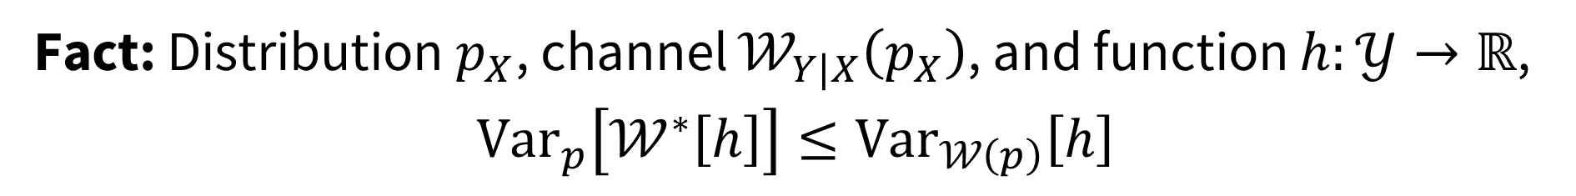
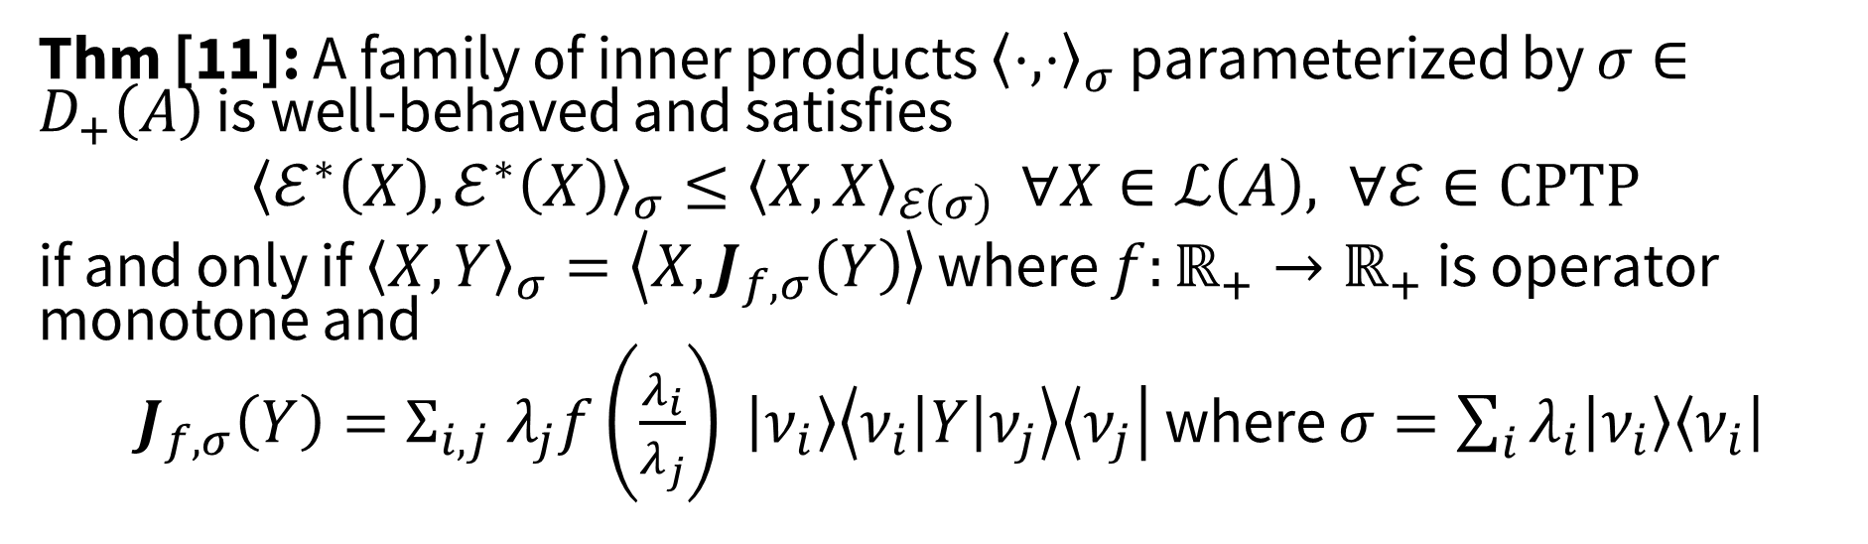
Petz’s $L_{f}^{2}\left(σ\right)$-Measure Spaces
Fact: Distribution $p_{X}$, channel $𝒲_{Y|X}\left(p_{X}\right)$, and function $h:𝒴→ℝ$,
$Var_{p}\left[𝒲^{∗}\left[h\right]\right]≤Var_{𝒲\left(p\right)}\left[h\right]$
Thm [11]: A family of inner products ${\left\langle ⋅,⋅\right\rangle }_{σ}$ parameterized by $σ∈D_{+}\left(A\right)$ is well-behaved and satisfies
${\left\langle ℰ^{∗}\left(X\right),ℰ^{∗}\left(X\right)\right\rangle }_{σ}≤{\left\langle X,X\right\rangle }_{ℰ\left(σ\right)}$ $∀X∈ℒ\left(A\right), ∀ℰ∈CPTP$
if and only if ${\left\langle X,Y\right\rangle }_{σ}=\left\langle X,J_{f,σ}\left(Y\right)\right\rangle$ where $f:ℝ_{+}→ℝ_{+}$ is operator monotone and
$J_{f,σ}\left(Y\right)=Σ_{i,j} λ_{j}f\left(\frac{λ_{i}}{λ_{j}}\right) \left|ν_{i}\right\rangle \left\langle ν_{i}\left|Y\right|ν_{j}\right\rangle \left\langle ν_{j}\right|$ where $σ=\sum_{i}{λ_{i}\left|ν_{i}\right\rangle \left\langle ν_{i}\right| }$
[11] Petz. “Monotone Metrics on Matrix Spaces,” 1996..

Slide 9
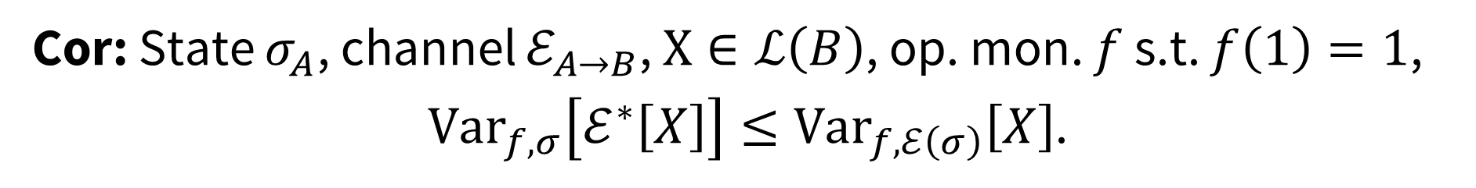

Petz’s $L_{f}^{2}\left(σ\right)$-Measure Spaces
Quantumly, ${\left\langle G,H\right\rangle }_{f,σ}≔\left\langle G,J_{f,σ}\left(H\right)\right\rangle$ where $f$ op. mon.
$$𝔼_{p}\left[H\right]≔{\left\langle I,H\right\rangle }_{f,σ}=Tr\left[σH\right]$$
$$Var_{f,σ}\left[H\right]≔{\left\langle H−𝔼_{f,σ}\left[H\right]I,H−𝔼_{f,σ}\left[H\right]I\right\rangle }_{f,σ}$$
Cor: State $σ_{A}$, channel $ℰ_{A→B}$, $X∈ℒ\left(B\right)$, op. mon. $f$ s.t. $f\left(1\right)=1$,
$Var_{f,σ}\left[ℰ^{∗}\left[X\right]\right]≤Var_{f,ℰ\left(σ\right)}\left[X\right]$.

Slide 10


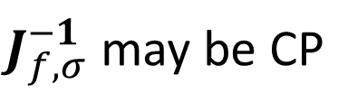


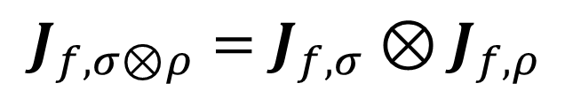
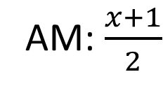

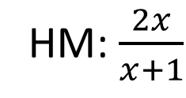


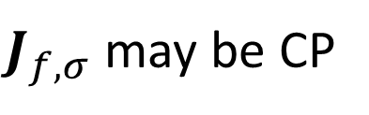
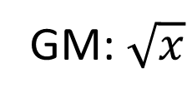

Choice of Operator Monotone Function
$$f_{1}\left(x\right)=x^{1}$$
$${\left\{f_{k}\left(x\right)≔x^{k}\right\}}_{k∈\left[0,1\right]}$$
$$J_{f,σ⊗ρ}=J_{f,σ}⊗J_{f,ρ}$$
$J_{f,σ}$ may be CP
$J_{f,σ}^{−1}$ may be CP
$$ℳ_{St}≔\left\{f\left(1\right)=1,f\left(x\right)=xf\left(x^{−1}\right)\right\}$$
HM: $\frac{2x}{x+1}$
$$≤$$
GM: $\sqrt{x}$
$$≤$$
LM: $\frac{x−1}{\log\left(x\right)}$
$$≤$$
AM: $\frac{x+1}{2}$
$$f_{0}\left(x\right)=x^{0}$$
[13] Kubo & Ando. “Means of Positive Linear Operators,” 1980.
[14] Petz & Ghinea. “Introduction to quantum Fisher information,” 2011.

Slide 11
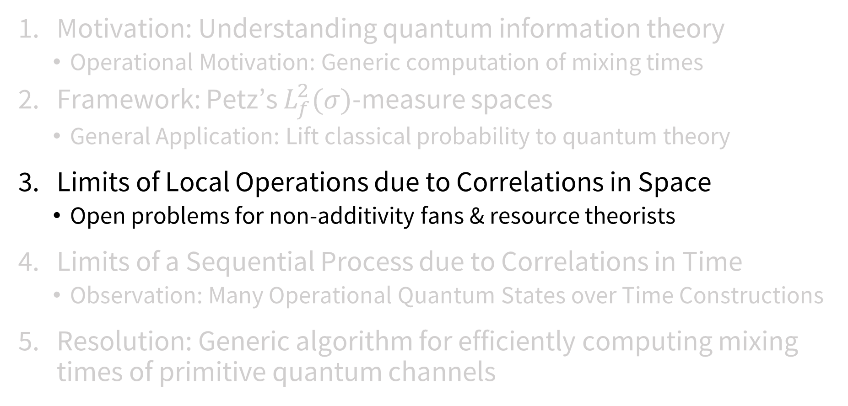
Outline
Motivation: Understanding quantum information theory
  Operational Motivation: Generic computation of mixing times
Framework: Petz’s $L_{f}^{2}(σ)$-measure spaces
  General Application: Lift classical probability to quantum theory
Limits of Local Operations due to Correlations in Space
  Open problems for non-additivity fans & resource theorists
Limits of a Sequential Process due to Correlations in Time
  Observation: Many Operational Quantum States over Time Constructions
Resolution: Generic algorithm for efficiently computing mixing times of primitive quantum channels

Slide 12




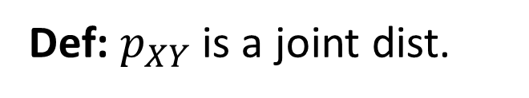
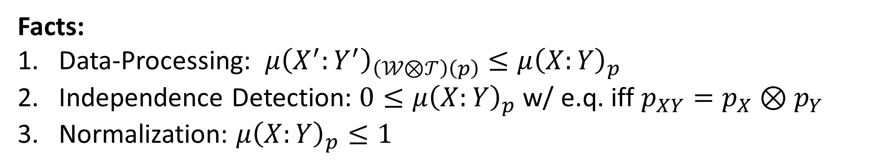




Classical Maximal Correlation Coefficient
Def: $p_{XY}$ is a joint dist.
$$g$$
$${μ\left(X:Y\right)}_{p}=\max{ \left|𝔼_{p_{XY}}\left[g⋅h\right]\right|}$$
$$s.t. 𝔼_{p_{X} }\left[g\right]=0=𝔼_{p_{Y} }\left[h\right]$$
$$p_{XY}^{ }$$
$$h$$
$${Var}_{p_{X} }\left[g\right]=1={Var}_{p_{Y} }\left[h\right]$$
$$g:𝒳→ℝ$$
$$h:𝒴→ℝ$$
Facts:
Data-Processing: $μ{\left(X^{′}:Y^{′}\right)}_{\left(𝒲⊗𝒯\right)\left(p\right)}≤μ{\left(X:Y\right)}_{p}$
Independence Detection: $0≤μ{\left(X:Y\right)}_{p}$ w/ e.q. iff $p_{XY}=p_{X}⊗p_{Y}$
Normalization: $μ{\left(X:Y\right)}_{p}≤1$

Slide 13






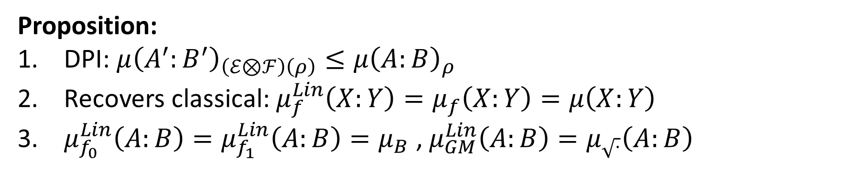



Quantum Maximal Correlation Coefficients
Def: $ρ_{AB}$ is a quantum state, $f$ op. mon. s.t. $f\left(1\right)=1$
$$f$$
$$Lin$$
$${μ_{f}\left(A:B\right)}_{ρ}=\max{ \left|Tr\left[X⊗Y^{∗}ρ_{AB}\right]\right|}$$
$$p_{XY}^{ }$$
$$s.t. 𝔼_{f,ρ_{A}}\left[X\right]=0=𝔼_{f,ρ_{B}}\left[Y\right]$$
$$g$$
$${Var}_{f,ρ_{A}}\left[X\right]=1={Var}_{f,ρ_{B} }\left[Y\right]$$
$$X∈Herm\left(A\right)$$
$$Y∈Herm(B)$$
$$X∈ℒ\left(A\right)$$
$$Y∈ℒ(B)$$
Proposition:
DPI: $μ{\left(A^{′}:B^{′}\right)}_{\left(ℰ⊗ℱ\right)\left(ρ\right)}≤μ{\left(A:B\right)}_{ρ}$
Recovers classical: $μ_{f}^{Lin}\left(X:Y\right)=μ_{f}\left(X:Y\right)=μ\left(X:Y\right)$
$μ_{f_{0}}^{Lin}\left(A:B\right)=μ_{f_{1}}^{Lin}\left(A:B\right)=μ_{B}$ , $μ_{GM}^{Lin}\left(A:B\right)=μ_{\sqrt{⋅}}\left(A:B\right)$

Slide 14
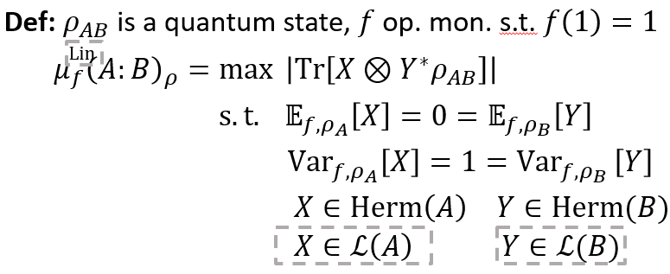
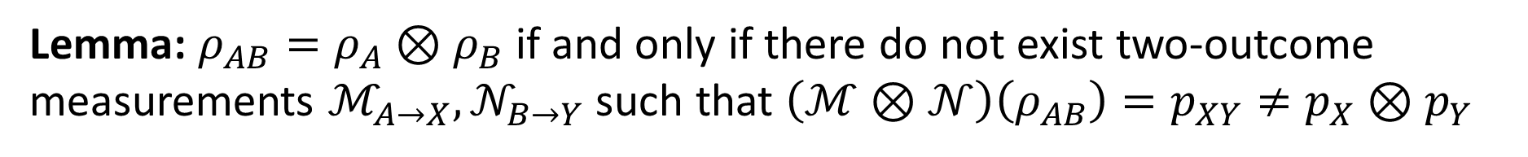

Quantum Maximal Correlation Coefficients
$$g$$
$$p_{XY}^{ }$$
$$h$$
Proposition: For all operator monotone $f$,
$μ_{f}^{\left(Lin\right)}\left(A:B\right)=0$ if and only if $ρ_{AB}=ρ_{A}⊗ρ_{B}$
Lemma: $ρ_{AB}=ρ_{A}⊗ρ_{B}$ if and only if there do not exist two-outcome measurements $ℳ_{A→X}, 𝒩_{B→Y}$ such that $\left(ℳ⊗𝒩\right)\left(ρ_{AB}\right)=p_{XY}≠p_{X}⊗p_{Y}$

Slide 15
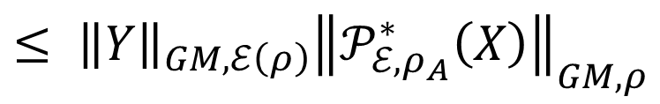

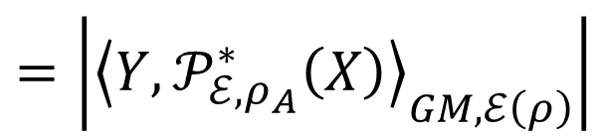


Quantum Maximal Correlation Coefficients
Proposition: For $f≥f_{GM}$, $μ_{f}^{Lin}\left(A:B\right)≤1$.
Lemma: For any $ρ_{AB}$, there exists a unique q. chan. $ℰ_{A^{′}→B}$ such that
$ρ_{AB}=\left(id_{A}⊗ℰ_{A^{′}→B}\right)\left(ψ_{ρ_{A}}\right)$ where $ψ_{ρ_{A}}≔ρ_{A}^{1/2}Φ^{+}ρ_{A}^{1/2}$.
Observation: $ψ_{ρ_{A}}≔ρ_{A}^{1/2}Φ^{+}ρ_{A}^{1/2}$ $=Ω_{J_{GM,ρ_{A}}}=\left(id_{A}⊗J_{GM,ρ_{A}}\right)\left(Φ^{+}\right)$
Proof Sketch: $\left|Tr\left[X⊗Yρ_{AB}\right]\right|$
$$=\left|Tr\left[X⊗Y^{∗}\left(id_{A}⊗ℰ∘J_{GM,ρ_{A}}\right)\left(Φ^{+}\right)\right]\right|$$
$$=\left|{\left\langle Y,𝒫_{ℰ,ρ_{A}}^{∗}\left(X\right)\right\rangle }_{GM,ℰ\left(ρ\right)}\right|$$
$$𝒫_{ℰ,ρ_{A}}≔J_{GM,ρ}∘ℰ∘J_{GM,ℰ\left(ρ\right)}^{−1}$$
$$≤ {\left\|Y\right\|}_{GM, ℰ\left(ρ\right)}{\left\|𝒫_{ℰ,ρ_{A}}^{∗}\left(X\right)\right\|}_{GM,ρ}$$
$$≤1$$

Slide 16
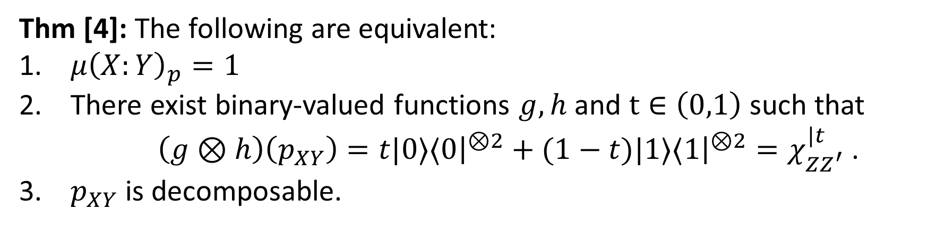

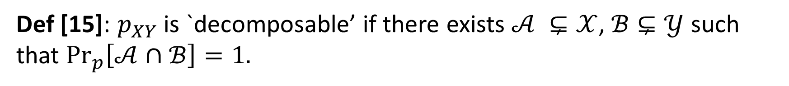



Quantum Maximal Correlation Coefficients
Def [15]: $p_{XY}$ is `decomposable’ if there exists $𝒜 ⊊𝒳$, $ℬ⊊𝒴$ such that $\underset{p}{Pr}\left[𝒜∩ℬ\right]=1.$
Thm [4]: The following are equivalent:
$μ{\left(X:Y\right)}_{p}=1$
There exist binary-valued functions $g,h$ and $t∈\left(0,1\right)$ such that
$\left(g⊗h\right)\left(p_{XY}\right)=t|0⟩⟨0{\left.​\right|}^{⊗2}+(1−t)|1⟩⟨1{\left.​\right|}^{⊗2}=χ_{ZZ^{′}}^{|t}$.
$p_{XY}$ is decomposable.
$$g$$
$$p_{XY}^{ }$$
$${χ^{|t}}_{ZZ^{′}}^{ }$$
$$h$$
[15] Ahlswede & Gács. “Spreading of Sets in Product Spaces and Hypercontraction of the Markov Operator,” 1976.
[4] Witsenhausen. “On Sequences of Pairs of Dependent Random Variables,” 1975.

Slide 17





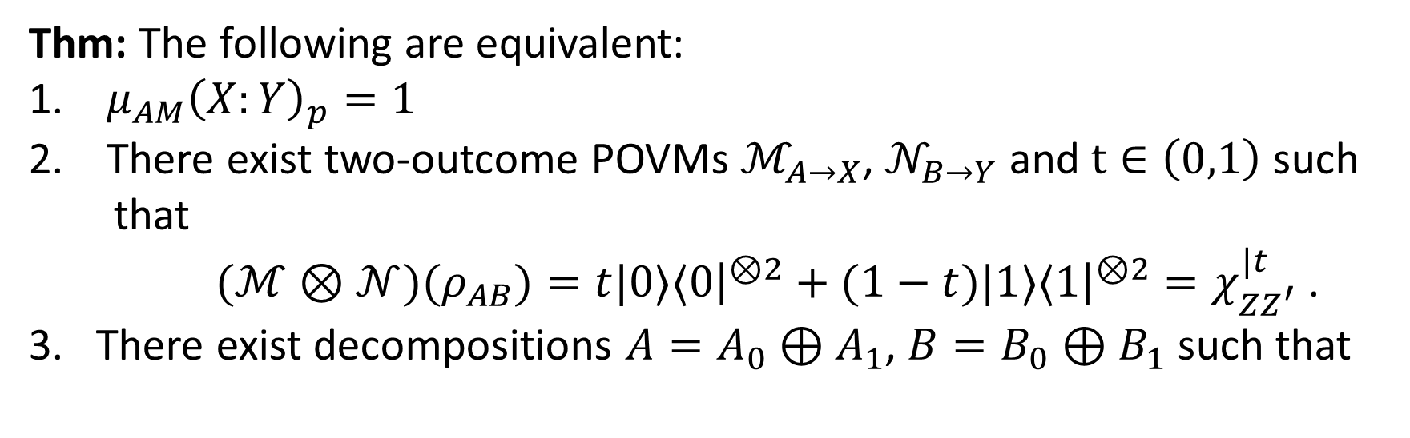


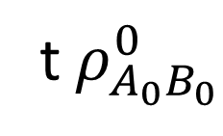







Quantum Maximal Correlation Coefficients
Thm: The following are equivalent:
$μ_{AM}{\left(X:Y\right)}_{p}=1$
There exist two-outcome POVMs $ℳ_{A→X}$, $𝒩_{B→Y}$ and $t∈\left(0,1\right)$ such
that
$(ℳ⊗𝒩)(ρ_{AB})=t|0⟩⟨0{\left.​\right|}^{⊗2}+(1−t)|1⟩⟨1{\left.​\right|}^{⊗2}=χ_{ZZ^{′}}^{|t}$.
There exist decompositions $A=A_{0}⊕A_{1}$, $B=B_{0}⊕B_{1}$ such that
t$ρ_{A_{0}B_{0}}^{0}$
$$0$$
$$0$$
$$X$$
Notion of
Quantum Decomposable
$$\begin{matrix}0 \\ 0\end{matrix}$$
$$0$$
$$0$$
$$\begin{matrix}0 \\ 0\end{matrix}$$
$$ρ_{AB}=$$
$$0$$
$$0$$
$$X^{∗}$$
$$0$$
$$0$$
$$\overline{t} ρ_{A_{1}B_{1}}^{1}$$

Slide 18
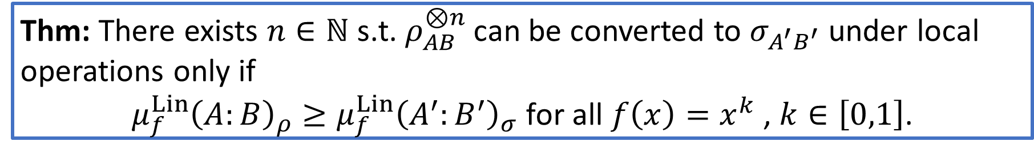
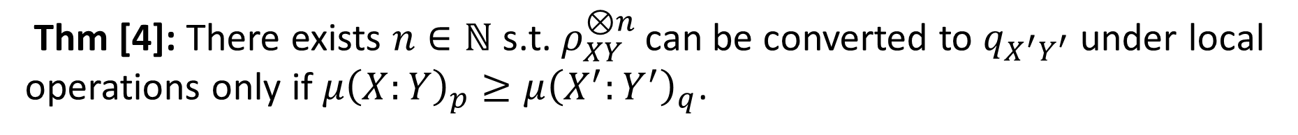
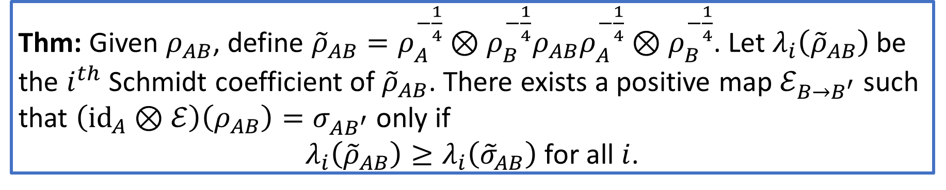
Q. Max. Corr. Coeffs. as Strong Monotones
Thm [4]: There exists $n∈ℕ$ s.t. $ρ_{XY}^{⊗n}$ can be converted to $q_{X^{′}Y^{′}}$ under local operations only if $μ{\left(X:Y\right)}_{p}≥μ{\left(X^{′}:Y^{′}\right)}_{q}$.
Thm: There exists $n∈ℕ$ s.t. $ρ_{AB}^{⊗n}$ can be converted to $σ_{A^{′}B^{′}}$ under local
operations only if
$μ_{f}^{Lin}{\left(A:B\right)}_{ρ}≥μ_{f}^{Lin}{\left(A^{′}:B^{′}\right)}_{σ}$ for all $f\left(x\right)=x^{k}$ , $k∈\left[0,1\right]$.
Thm: Given $ρ_{AB}$, define ${\tilde{ρ}}_{AB}=ρ_{A}^{−\frac{1}{4}}⊗ρ_{B}^{−\frac{1}{4}}ρ_{AB}ρ_{A}^{−\frac{1}{4}}⊗ρ_{B}^{−\frac{1}{4}}$. Let $λ_{i}\left({\tilde{ρ}}_{AB}\right)$ be
the $i^{th}$ Schmidt coefficient of ${\tilde{ρ}}_{AB}$. There exists a positive map $ℰ_{B→B^{′}}$ such
that $\left(id_{A}⊗ℰ\right)\left(ρ_{AB}\right)=σ_{AB^{′}}$ only if
$λ_{i}\left({\tilde{ρ}}_{AB}\right)≥λ_{i}\left({\tilde{σ}}_{AB}\right)$ for all $i$.
[4] Witsenhausen. “On Sequences of Pairs of Dependent Random Variables,” 1975.

Slide 19
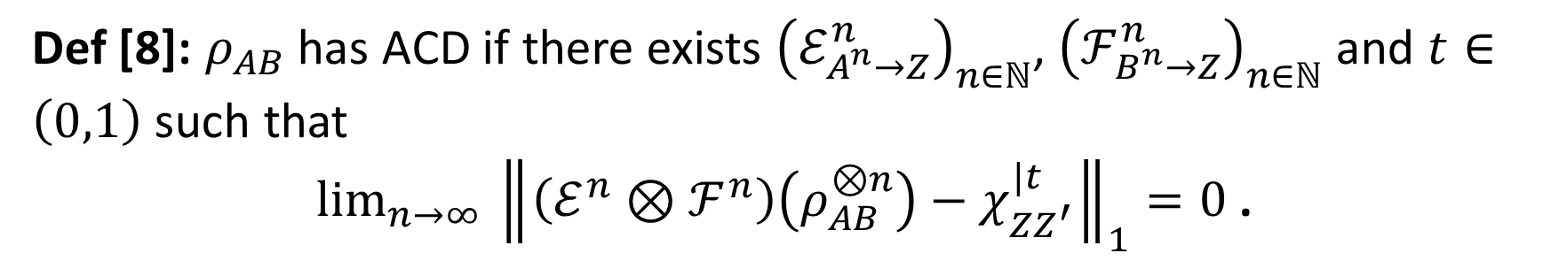
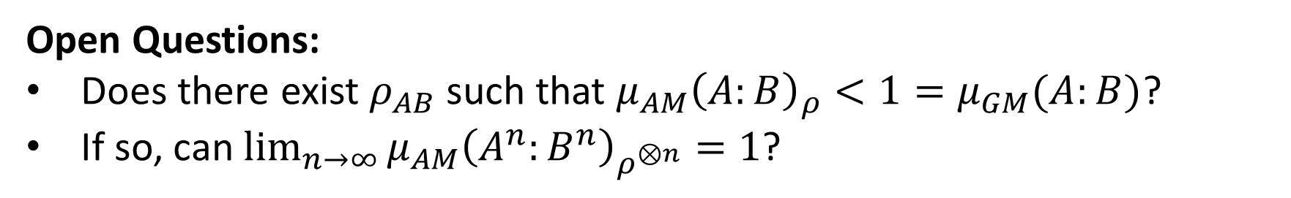
Asymptotic Common Data (ACD)
Def [8]: $ρ_{AB}$ has ACD if there exists ${\left(ℰ_{A^{n}→Z}^{n}\right)}_{n∈ℕ}$, ${\left(ℱ_{B^{n}→Z}^{n}\right)}_{n∈ℕ}$ and $t∈\left(0,1\right)$ such that
$lim_{n→∞ }{\left\|\left(ℰ^{n}⊗ℱ^{n}\right)\left(ρ_{AB}^{⊗n}\right)−χ_{ZZ^{′}}^{|t}\right\|}_{1}=0$ .
Classically, because $μ$ tensorizes, ACD iff $μ\left(X:Y\right)=1$
Quantumly, $μ_{AM}\left(A:B\right)$ doesn’t seem to tensorize
Thm: $ρ_{AB}$ has ACD only if $μ_{GM}{\left(A:B\right)}_{ρ}=1$ and $μ_{f_{k}}^{Lin}{\left(A:B\right)}_{ρ}=1$.
Open Questions:
Does there exist $ρ_{AB}$ such that $μ_{AM}{\left(A:B\right)}_{ρ}<1=μ_{GM}(A:B)$?
If so, can $\lim_{n→∞}{μ_{AM}{\left(A^{n}:B^{n}\right)}_{ρ^{⊗n}}}=1$?

Slide 20
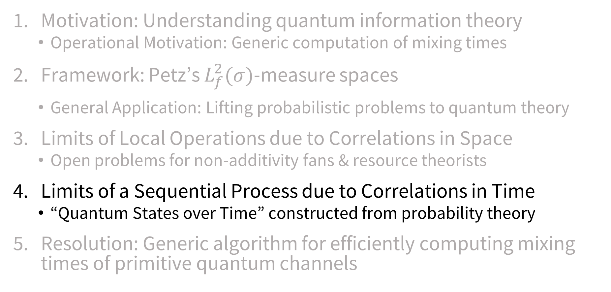
Outline
Motivation: Understanding quantum information theory
  Operational Motivation: Generic computation of mixing times
Framework: Petz’s $L_{f}^{2}(σ)$-measure spaces
  General Application: Lifting probabilistic problems to quantum theory
Limits of Local Operations due to Correlations in Space
  Open problems for non-additivity fans & resource theorists
Limits of a Sequential Process due to Correlations in Time
  “Quantum States over Time” constructed from probability theory
Resolution: Generic algorithm for efficiently computing mixing times of primitive quantum channels

Slide 21

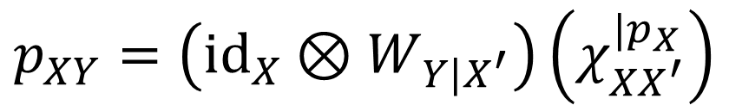


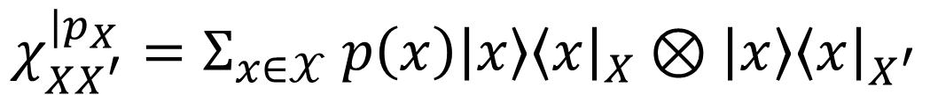

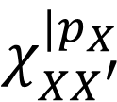


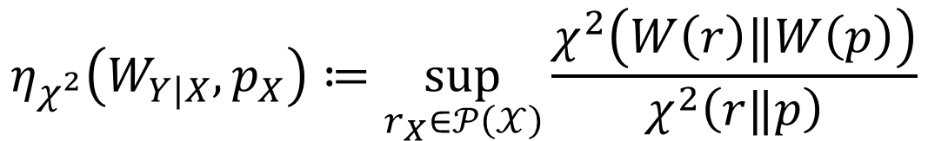



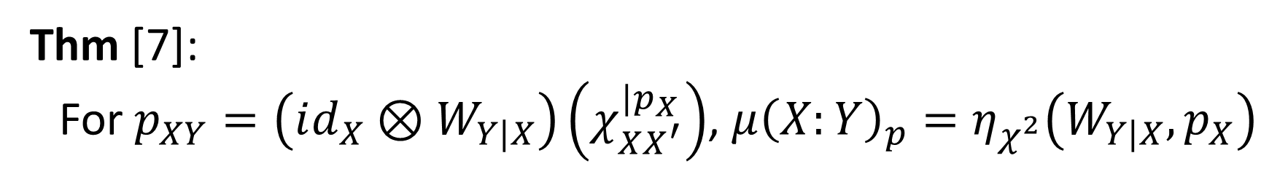
The Classical Theory’s Correspondence
$$X$$
$${id}_{X}$$
$$p_{XY}\left(x,y\right)=p_{Y|X}\left(y | x\right)p_{X}\left(x\right)$$
$$X$$
$$χ_{XX^{′}}^{|p_{X}}$$
$$p_{XY}$$
$$W_{Y|X}\left(y | x\right)≔p_{Y|X}\left(y | x\right)$$
$$W_{Y|X^{′}}$$
$$p_{XY}=\left(id_{X}⊗W_{Y|X^{′}}\right)\left(χ_{XX^{′}}^{|p_{X}}\right)$$
$$Y$$
$$X^{′}$$
$$χ_{XX^{′}}^{|p_{X}}=Σ_{x∈𝒳} p\left(x\right)\left|x\right\rangle {\left\langle x\right|}_{X}⊗\left|x\right\rangle {\left\langle x\right|}_{X^{′}}$$
Thm [7]:
For $p_{XY}=\left(id_{X}⊗W_{Y|X}\right)\left(χ_{XX^{′}}^{|p_{X}}\right)$, $μ{\left(X:Y\right)}_{p}=η_{χ^{2}}\left(W_{Y|X},p_{X}\right)$
$$η_{χ^{2}}\left(W_{Y|X},p_{X}\right)≔\sup_{r_{X}∈𝒫\left(𝒳\right)}{\frac{χ^{2}\left(W\left(r\right)‖W\left(p\right)\right)}{χ^{2}\left(r‖p\right)}}$$
[7] Raginsky. “Strong Data Processing Inequalities and $Φ$-Sobolev Inequalities for Discrete Channels,” 2016.

Slide 22
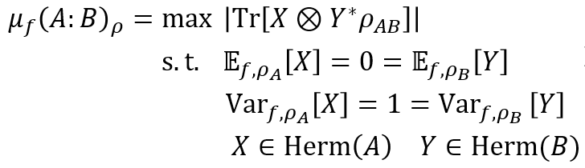
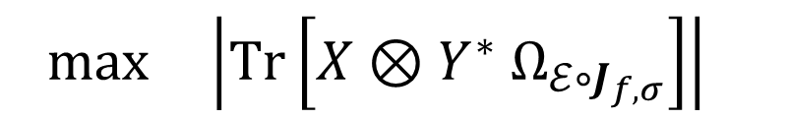
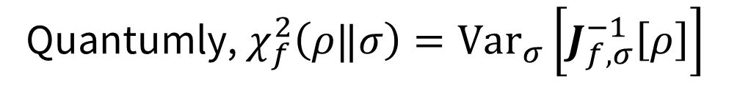






The Quantum Theory’s Correspondence
Classically, $χ^{2}\left(p‖q\right)=Var_{q}\left[\frac{p}{q}\right]$
Quantumly, $χ_{f}^{2}\left(ρ‖σ\right)=Var_{σ}\left[J_{f,σ}^{−1}\left[ρ\right]\right]$
$$η_{χ_{f}^{2}}\left(ℰ,σ\right)≔\sup_{ρ∈D\left(A\right)}{\frac{Var_{f,ℰ\left(σ\right)}\left[J_{f,ℰ\left(σ\right)}^{−1}\left(ℰ\left(ρ\right)\right)\right]}{Var_{f,σ}\left[J_{f,σ}^{−1}\left(ρ\right)\right]}}$$
Lem: $σ_{A}>0$, $ℰ_{A→B}$ PTP map, $f∈ℳ_{St}$
$$\sqrt{η_{χ_{f}^{2}}\left(ℰ,σ\right)}=$$
$$max \left|Tr\left[X⊗Y^{∗} Ω_{ℰ∘J_{f,σ}}\right]\right|⁡$$
$$s.t. 𝔼_{σ}\left[X\right]=𝔼_{ℰ\left(σ\right)}\left[Y\right]=0$$
$$Var_{f,σ}[X]={Var}_{f,ℰ\left(σ\right)}\left[Y\right]=1$$

Slide 23



Quantum Couplings
Def: A coupling of $p_{X},q_{Y}$ is a joint distribution $r_{XY}$ such that $r_{X}=p_{X}$ and $r_{Y}=q_{Y}$
Def: A relaxed coupling of $ρ_{A},σ_{B}$ is a Hermitian operator $H_{AB}$ such that $H_{A}=ρ_{A}$ and $H_{B}=σ_{B}$. It’s a coupling if $H_{AB}≥0$.
Prop: Writing the Choi operator in the eigenbasis of $ρ_{A}$, for $f∈ℳ_{St}$, $Ω_{ℰ∘J_{f,ρ_{A}}}=\left(id_{A}⊗ℰ∘J_{f,ρ_{A}}\right)\left(Φ^{+}\right)$ is a relaxed coupling of $ρ_{A}$, $ℰ\left(ρ_{A}\right)$

Slide 24


















The Quantum Theory’s Correspondence
$$A$$
$$id$$
Thm: $σ_{A}>0$, $ℰ_{A→B}$ PTP map, $f∈ℳ_{St},$
$$\sqrt{η_{χ_{f}^{2}}\left(ℰ,σ\right)}=μ_{f}{\left(A:B\right)}_{Ω_{ℰ∘J_{f,σ}}}$$
$$A$$
$$Ω_{J_{f,σ}}$$
$$Ω_{ℰ∘J_{f,σ}}$$
$$ℰ_{\overline{A}→B}$$
$$B$$
$$\overline{A}$$
$$A$$
$$id$$
$$A$$
Cor: For any $ρ_{AB}$ there exists $ℰ_{A→B}$ such that
$$\sqrt{η_{χ_{GM}^{2}}\left(ℰ,ρ_{A}\right)}=μ_{GM}{\left(A:B\right)}_{ρ_{AB}}$$
$$ψ_{ρ}$$
$$ρ_{AB}$$
$$ℰ_{\overline{A}→B}$$
$$B$$
$$\overline{A}$$

Slide 25

The Quantum Theory’s Correspondence
$$A$$
$$id$$
Thm: $σ_{A}>0$, $ℰ_{A→B}$ PTP map, $f∈ℳ_{St},$
$$\sqrt{η_{χ_{f}^{2}}\left(ℰ,σ\right)}=μ_{f}{\left(A:B\right)}_{Ω_{ℰ∘J_{f,σ}}}$$
$$A$$
$$Ω_{J_{f,σ}}$$
$$Ω_{ℰ∘J_{f,σ}}$$
$$ℰ_{\overline{A}→B}$$
$$B$$
$$\overline{A}$$
Observation: $f$-couplings are quantum states over time:
  $Ω_{ℰ∘J_{AM},σ}$ $=\left(J_{AM,σ⊗I}\right)\left(Ω_{ℰ}\right)=Ω_{ℰ}⋆σ$ [16]
  $Ω_{ℰ∘J_{GM},σ}=Ω_{ℰ}⋆σ$ [17]
[16] Fullwood & Parzygnat. “On Quantum States over Time,” 2022.
[17] Leifer & Spekkens. “Towards a Formulation of Quantum Theory as a Causally Neutral Theory of Bayesian Inference,” 2013.

Slide 26




Reversibility
$$𝒮_{f,ℰ,σ}≔J_{f,σ }∘ℰ^{∗}∘J_{f,ℰ\left(σ\right)}^{−1}$$
Petz Recovery Map when $f=GM$
Prop: 1. $\left(𝒮_{f,ℰ,σ} ∘ℰ\right)\left(σ\right)=σ$
2. ${\left\|\sqrt{𝒮_{f,ℰ,σ} ∘ℰ} \right\|}_{f,σ→f,σ}≤1$
Thm: Operator monotone $f∈ℳ_{St}$, $ρ≪σ$, and $ℰ_{A→B}$ 2-positive and TP,
$χ_{f}^{2}\left(ℰ\left(ρ\right)‖ℰ\left(σ\right)\right)=χ_{f}^{2}\left(ρ‖σ\right)$ iff $𝒮_{f,ℰ,σ}\left(ℰ\left(ρ\right)\right)=ρ$
Recovers some results from [18,19] as special cases
[18] Jencova. “Preservation of quantum Rényi relative entropy implies existence of a recovery map,” 2017.
[19] Gao et al. “Sufficient Statistic and Recoverability via Quantum Fisher Information Metrics,” 2023.

Slide 27


Computing Contraction
$$𝒮_{f,ℰ,σ}≔J_{f,σ }∘ℰ^{∗}∘J_{f,ℰ\left(σ\right)}^{−1}$$
Recovers Petz when $f=GM$
Prop: Let $f∈ℳ_{St}$, $σ_{A}>0$, $ℰ_{A→B}$ PTP. With respect to Hilbert space $\left(Herm\left(A\right),\left\langle ⋅,J_{f,σ}^{−1}\left[⋅\right]\right\rangle \right)$,
$η_{χ_{f}^{2}}\left(ℰ,σ\right)=λ_{2}\left(𝒮_{f,ℰ,σ}∘ℰ\right)$
Prop:$\left\langle X,J_{f,σ}^{−1}\left[Y\right]\right\rangle =Σ_{i,j}\frac{1}{λ_{j}}\frac{1}{f}\left(\frac{λ_{i}}{λ_{j}}\right) {\overline{X}}_{i,j}Y_{i,j}$ is efficient to compute
Can calculate eigenvalues in this inner product space using Gram-Schmidt process

Slide 28

Computing Contraction
$$𝒮_{f,ℰ,σ}≔J_{f,σ }∘ℰ^{∗}∘J_{f,ℰ\left(σ\right)}^{−1}$$
Recovers Petz when $f=GM$
Thm: If $ℰ_{A→A}$ with full rank fixed point $ω$, there exists an efficient algorithm such that either
the mixing time found is finite
$η_{\text{ⅅ}}\left(𝒩,ω\right)=1$ for all $\text{ⅅ}$
  Because $∃ρ_{A}$ such that $\left(𝒫_{𝒩,σ}∘𝒩\right)\left(ρ\right)=ρ$
$$𝒩$$
$$𝒩$$
$$…$$
$$𝒩$$
$$ρ$$
$${≈_{δ}ω}_{A}$$
$$?$$
$$𝒩^{n}$$

Slide 29

Outlook
Limits of Local Operations due to Correlations in Space
  Up to a non-additivity question, extended entire classical theory
Limits of a Sequential Process due to Correlations in Time
  Correspondence with correlations in space
  New DPI saturation results
  Generic, efficient algorithm for mixing time of primitive channels
Technical Tools
  Non-Commutative $L_{f}^{2}\left(σ\right)$-spaces that admit data processing
  Various functional analytic identifications

Slide 30

Some Open Questions
Can one solve the non-additivity-like question?
Can one construct strong monotones for other quantum resource theories?
Is it useful to view QSOT in terms of operator monotone $f$?

Slide 31
Thank You For Listening!
Any Questions?
arXiv:2505.15281
qit.george@gmail.com

